Slide 1

…where Business Sustainability
makes good business sense
Business Sustainability in the age of exponential change
How to minimize the risk of Global Economic Disorder?
PART 1
Tony Czarnecki
Managing Partner, Sustensis
www.sustensis.co.uk
London, 8th November 2018

Slide 2
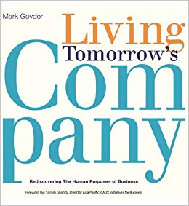



My journey from Business Sustainability consulting to futurism
Business Sustainability:
“How can companies
survive ‘for ever’”
Adapting the metaphor
© Copyright 2012-2018 Creatively United for the Planet Society
Humanity’s Transition
to coexistence with Superintelligence:
“How can Humanity
survive ‘for ever’”
Notes:
My interest in UBI goes two years back when I had a presentation here on “Real world policy changes for a radically better future”, where the subject of UBI was very prominent. It became so important to me that I dedicated to it a whole chapter in my new book “Who could save Humanity from Superintelligence?” Why have I put that subject of UBI in the context of the most advanced form of Artificial Intelligence?
This is the question I would like to answer in this presentation. Its main body will be the rationale for advancing UBI implementation and seeing it as a start to an indefinite process leading us to the time where most of us will be able to sustain ourselves, albeit at a minimum level, even if not working at all. This will also entail social consequences impacting us all.

Slide 3
What is a company for?
Notes:
.

Slide 4

The Craftsman’s World
Taylor
Cobbler
Carpenter
  One man produces a complete product
  Local supplies (overseas trade = expensive transport + risk)
  Local distribution

Slide 5
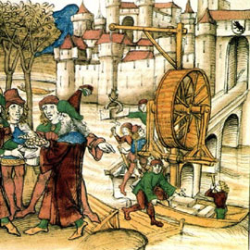
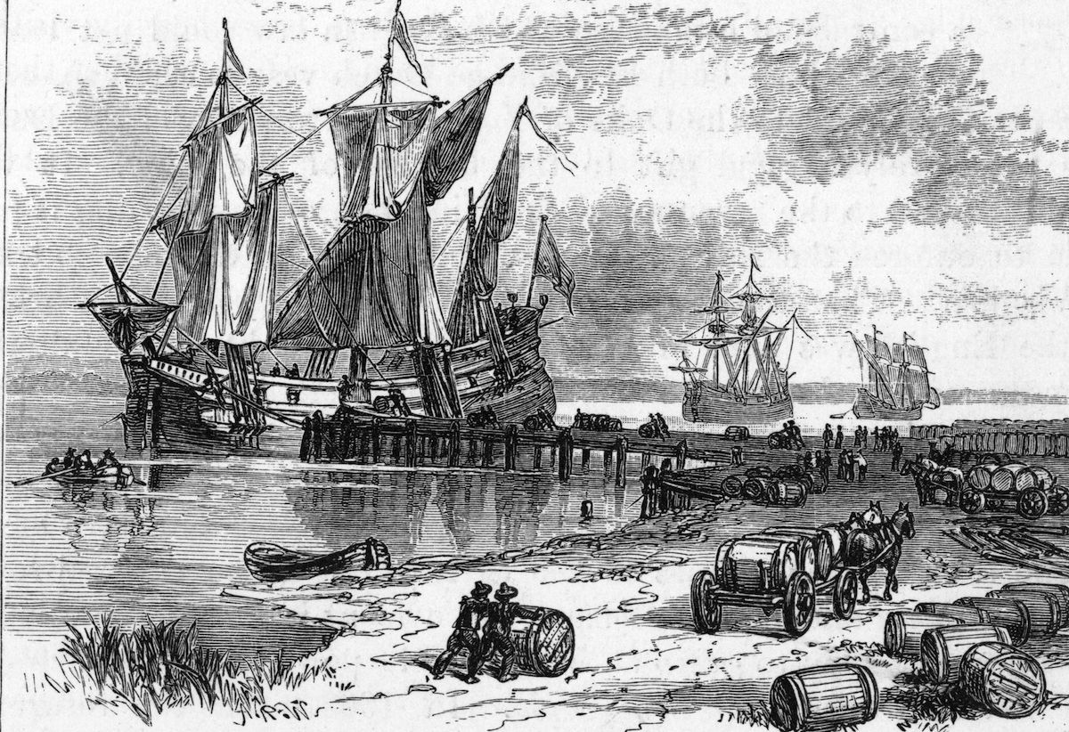
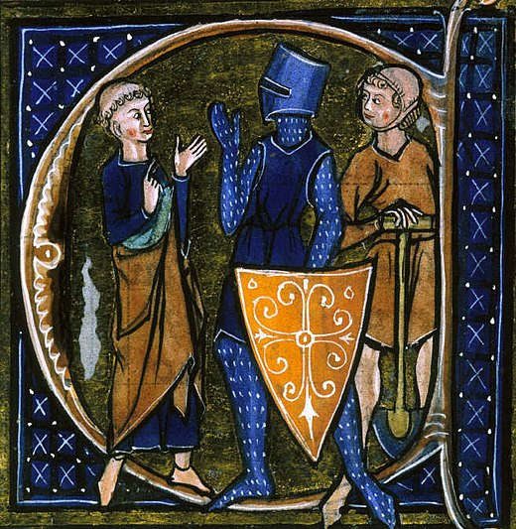
What is a company for?
Building a bridge between two villages
(a one-off goal)
Getting spice from India
(continuous goal - multiple voyages)
Medieval community
(peasants, clergy and knights )
The original purpose of a company was to meet societal needs
But the company’s purpose evolved over time

Slide 6
Adam Smith’s Creed for companies in 1700’
New technology requires a new approach to manufacturing
Manufacturing process requires division of labour - specialization
World-wide specialization based on country’s own resources

Slide 7
1855 - The end of family business. Long live a Limited Liability Company!
Large infrastructure projects – e.g. railways and canals
Overseas expansion – large ships (e.g. clippers)
Need of substantial investment
Lower the risk of company operations
Notes:
THEN WITH THE HELP OF JOHN WATT’S STEAM ENGINE ENABLING TECHNOLOGY, ADAM SMITH IN THE SECOND HALF OF 18TH CENTURY TURNED THE PRODUCTION PROCESS UPSIDE DOWN. INSTEAD OF ONE MAN DOING EVERYTHING HE SPLIT THE PROCESS INTO ACTIVITIES, EACH ONE EXECUTED BY A DIFFERENT PERSON.
THE SPECIALIZATION EXTENDED NOT ONLY TO THE PROCESS ITSELF BUT TO THE WORLD AS A WHOLE.
BRITAIN BECAME THE NATION OF GLOBAL TRADERS.

Slide 8
Companies in Early 1900’
Mass production requires extra specialization:
Enter Henry Ford And His Model “T”

Slide 9
Post-war period till 1980’
Post-war period till 1980’
Specialization led to building internal walls
Example: product supply to customers
“Get it out of town”
“Push to the group
companies”
“Freight rates”
“Cost per kg”
“Fill trucks with
anything”
“Batch size”
“Unit cost”
“Send it now”
Manufacturing
Central logistics
Group central traffic
Group company logistics

Slide 10
The roots of unsustainable business

Slide 11
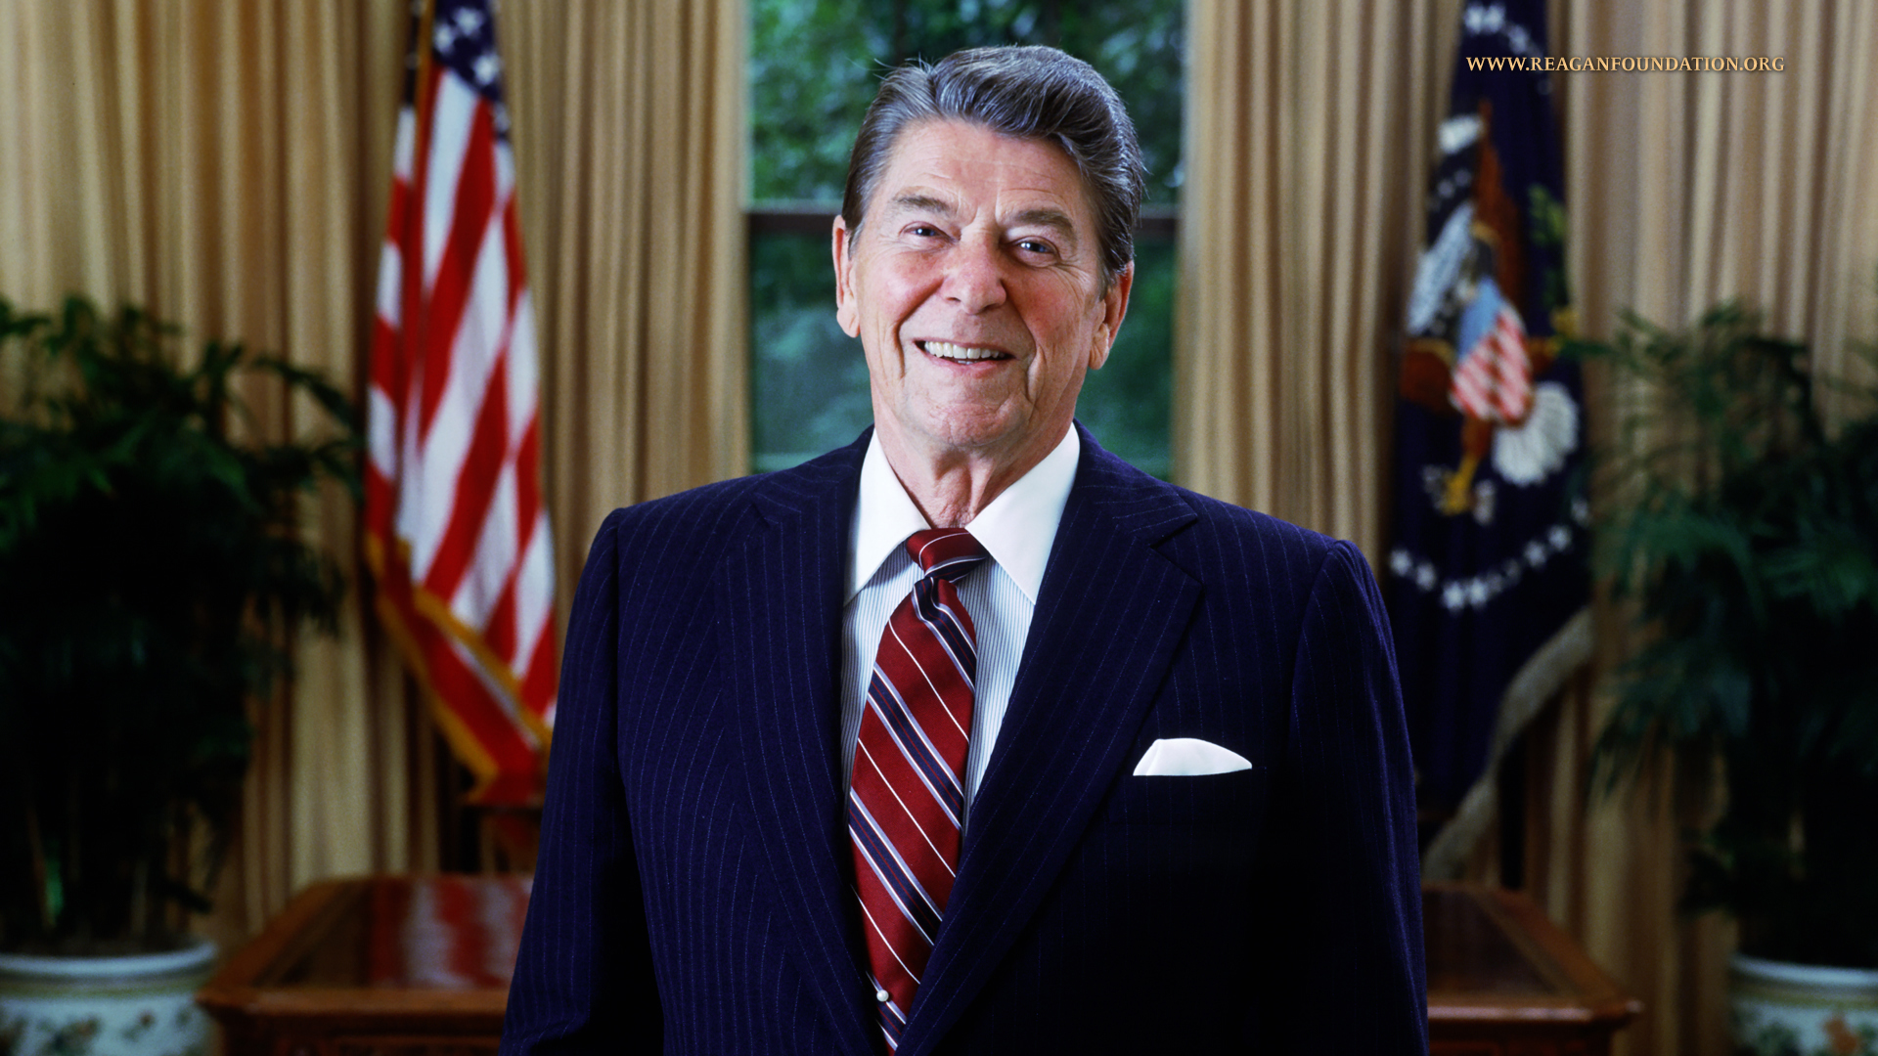
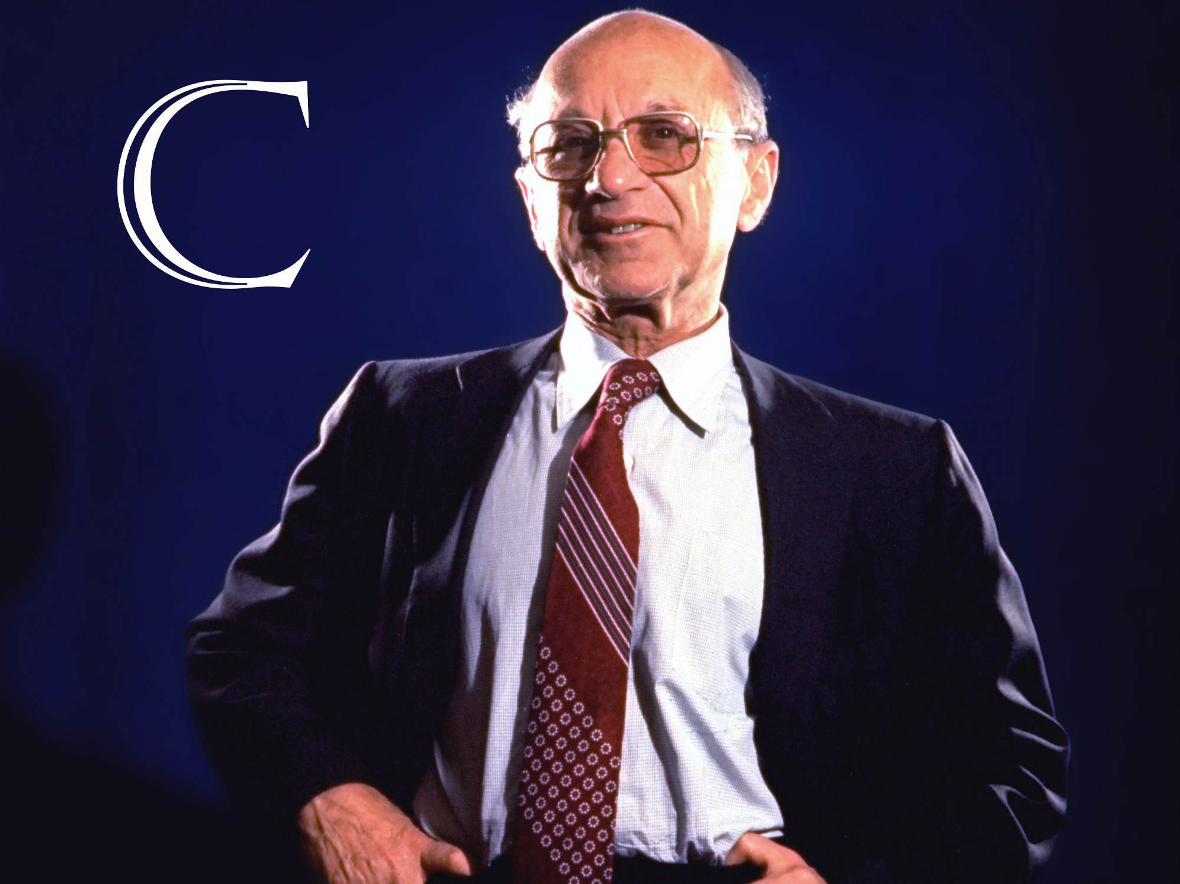
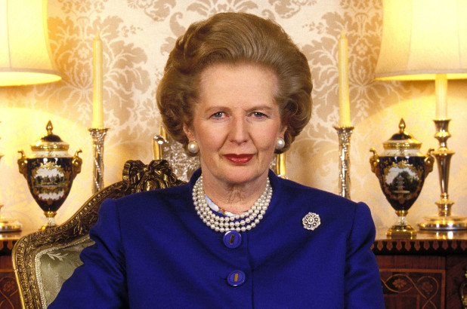
1980’ and the age of the ‘Perfect Market’
Ronald Reagan
Milton Friedman
Margaret Thatcher
“There is one and only one social responsibility of business … to increase its profits”
Reganomics and the end of merchant-based capitalism
End of control on the movement of capital across borders - globalisation
Debt-driven company expansion and short-termism
SE – the place to sell companies rather than stock - company age 15 years (67 in 1920’)
Electronic trading changes the nature of investment (97 microsecond deals)

Slide 12
Result: Unsustainable Business
The market capitalization of the Priceline.com fell from $162 in 1999 to $1 in 2000
The M&S crisis: 1998: £1bn profit. 1999: profits £50m, shares fall dramatically
GEC/Marconi: In 1998 “prime defence contractor ” becomes a dot.com/telecom company run like investment portfolio. In 2000: share value falls from £5 to 5p
And then the Enron Scandal - the best CSR company in the USA comes as a big fraud

Slide 13
So what went wrong?
The market i.e. companies, investors, analysts and auditors forgot about the business fundamentals:
  In the long-term share value cannot grow faster than the rate of growth
  Profits are earned in operating businesses and cannot be continuously improved through “financial engineering” (swapping costs, revenues and tax duties in large corporations) – e.g. Carillion

Slide 14
The risk of Global Economic Disorder and AI-driven Technological Unemployment

Slide 15
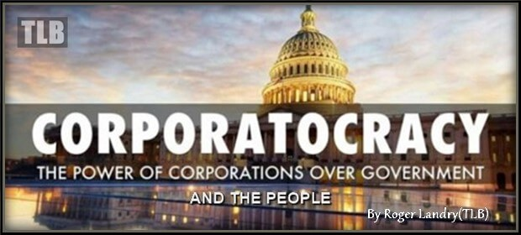
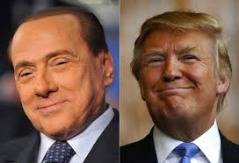
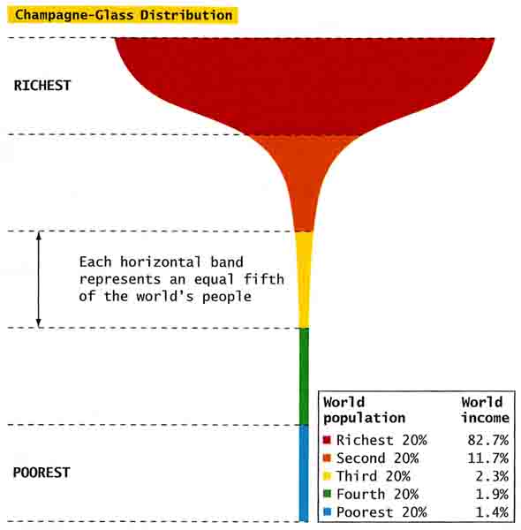

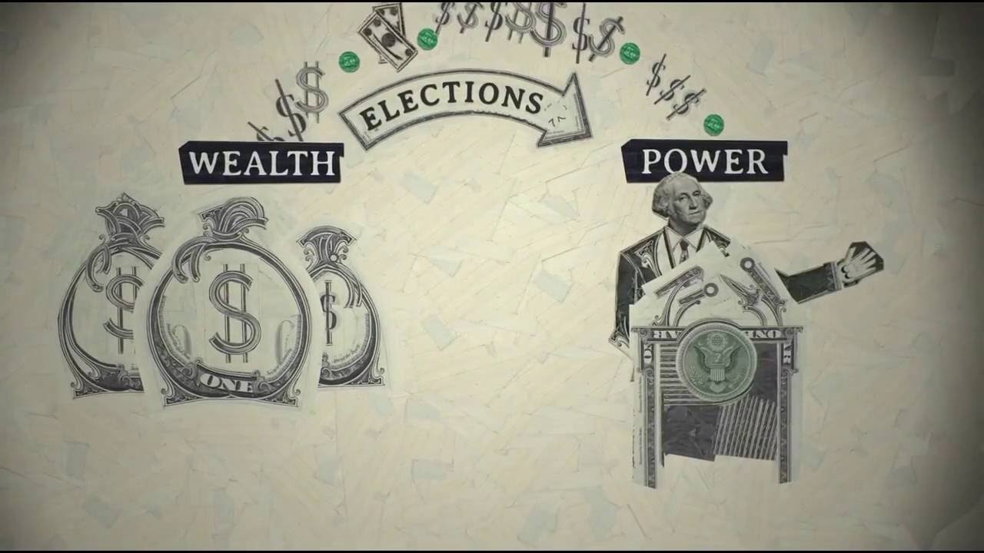
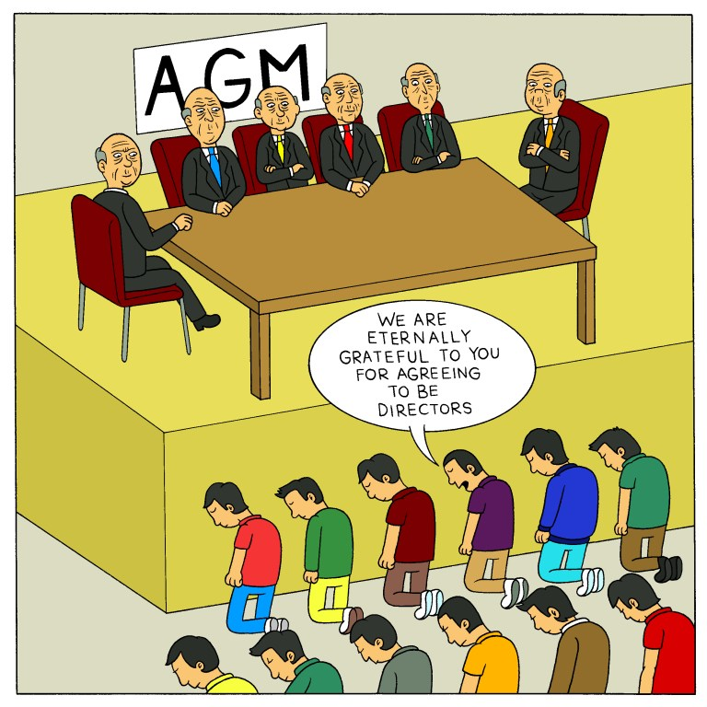
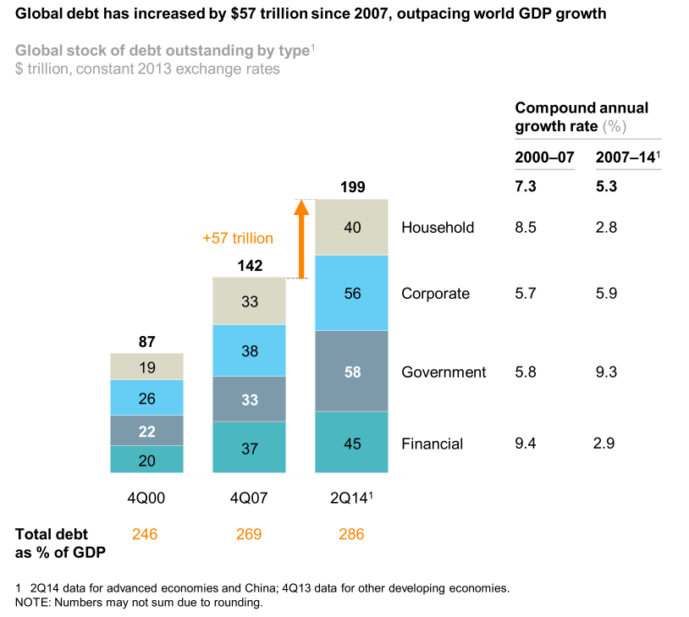
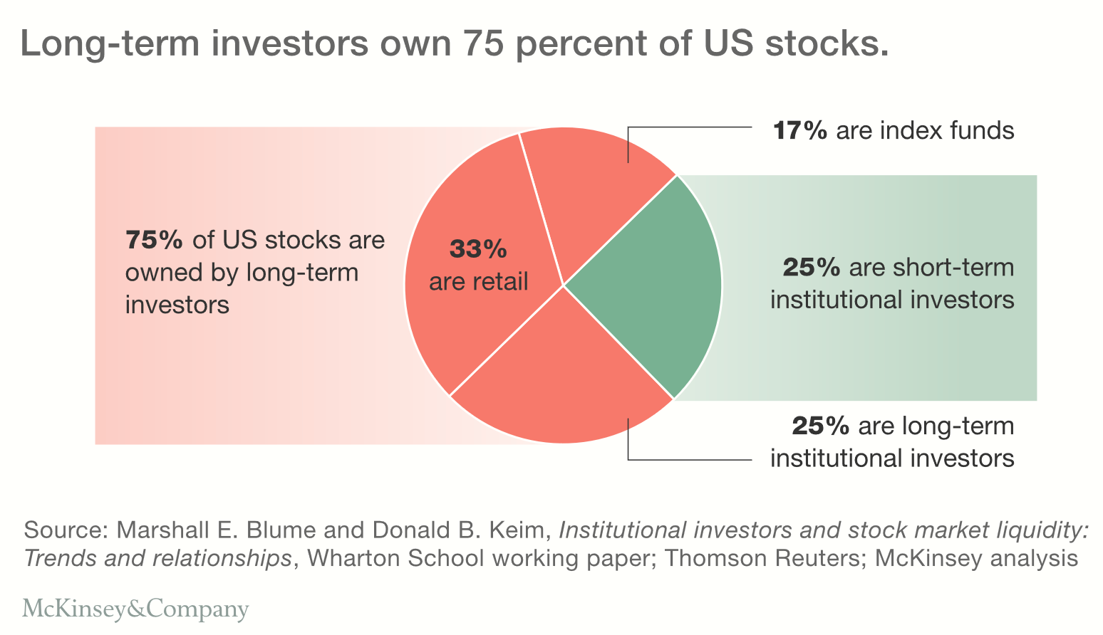
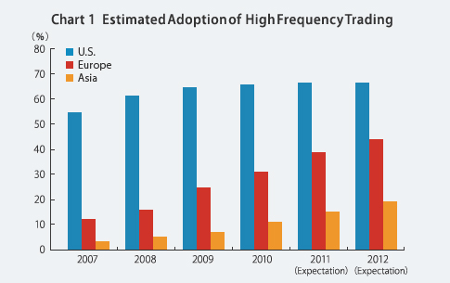
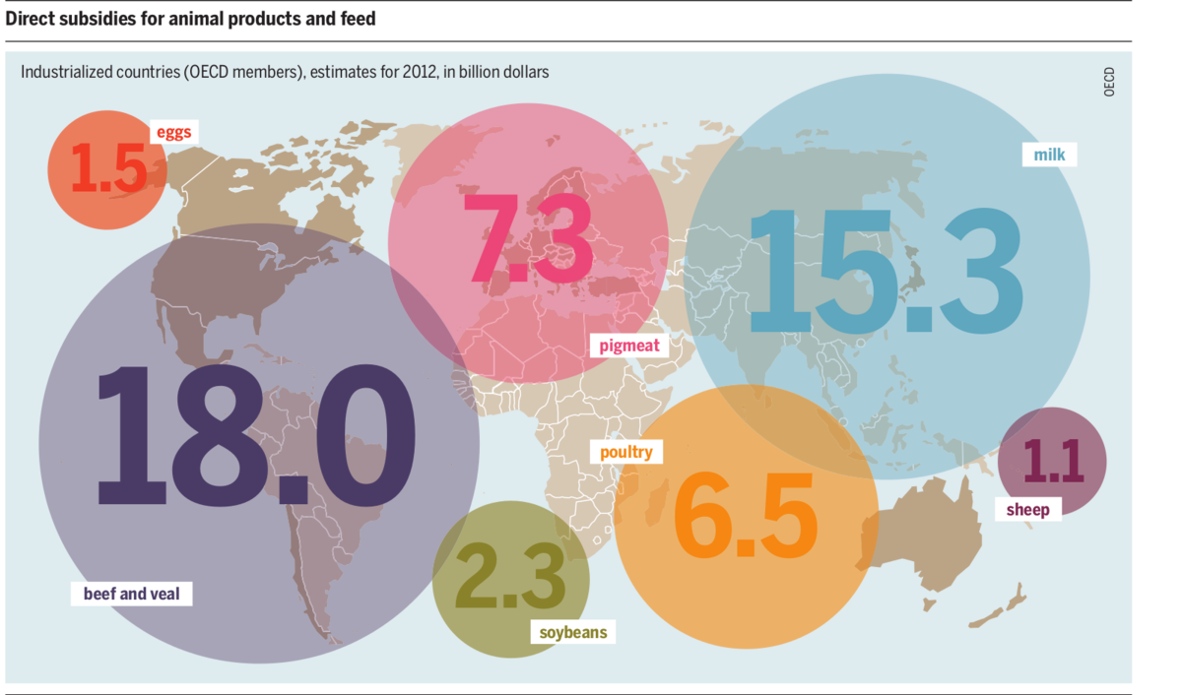
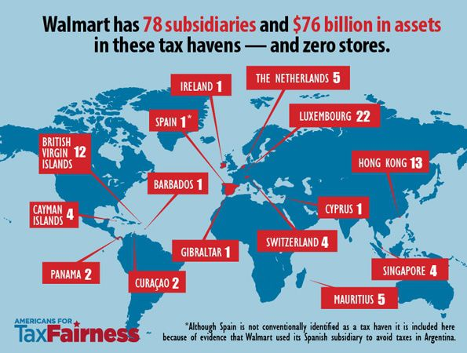
10 underlying risks of Global Economic Disorder
Fusion of money & politics
Populism
Extreme concentration of wealth
Product obsolescence
CEO. vs Shareholders
Sovereign, household & corporate debt
Maximizing shareholder value = short-termism
Failing financial systems
Subsidised industries
Tax Havens

Slide 16
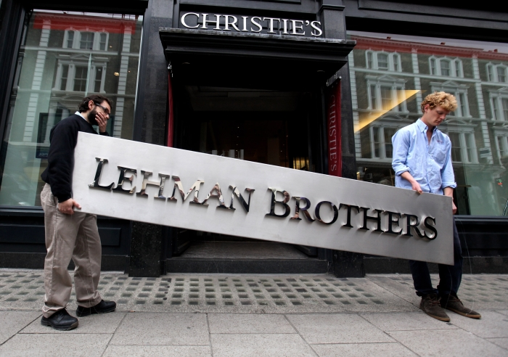
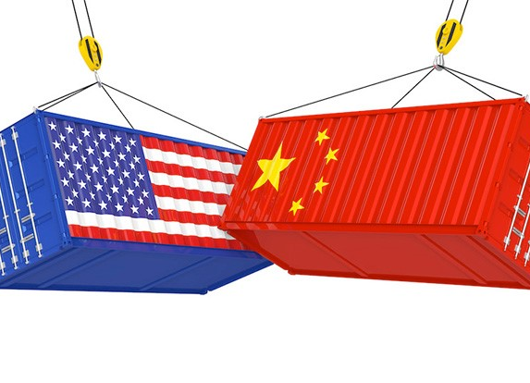
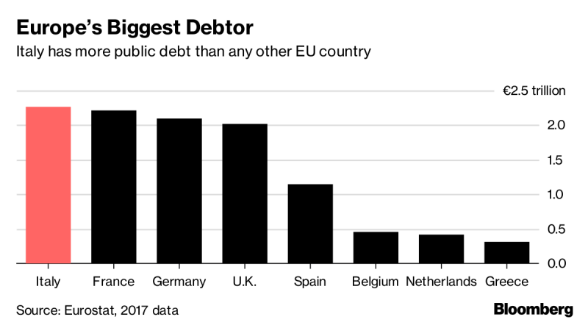
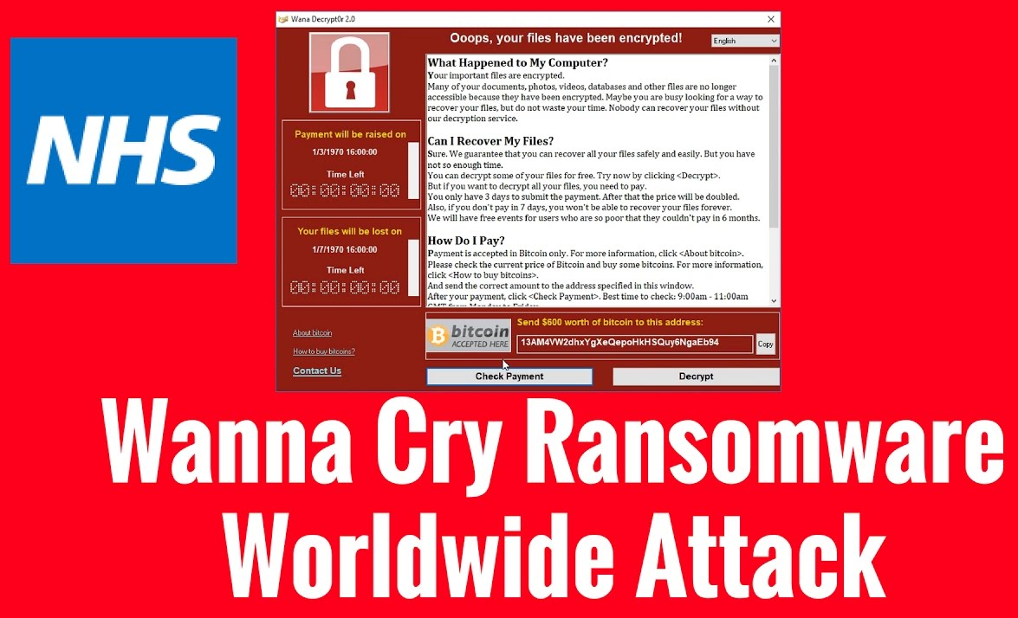

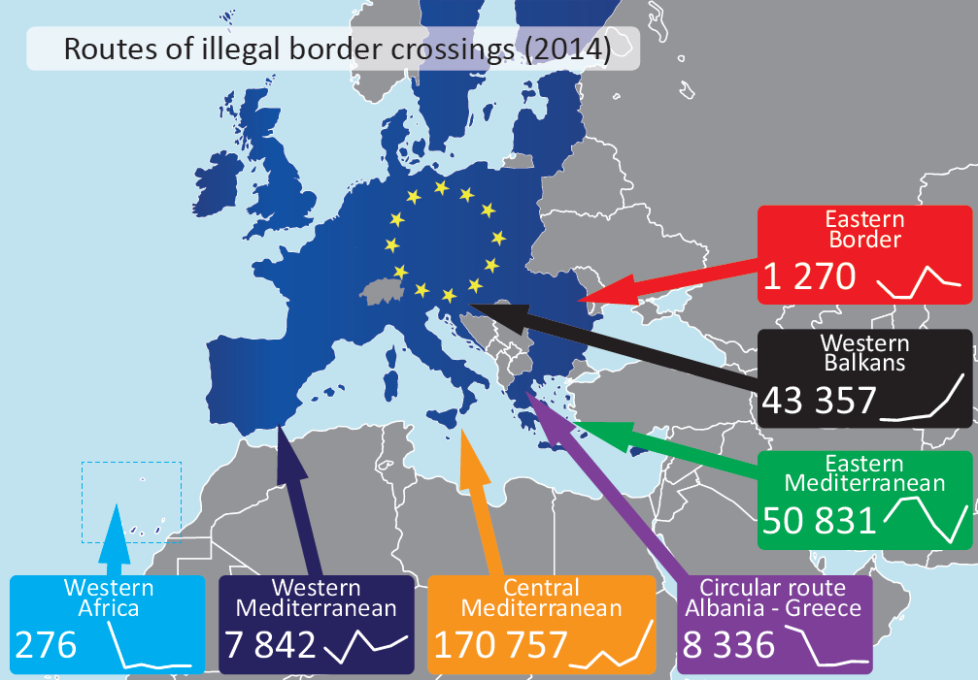
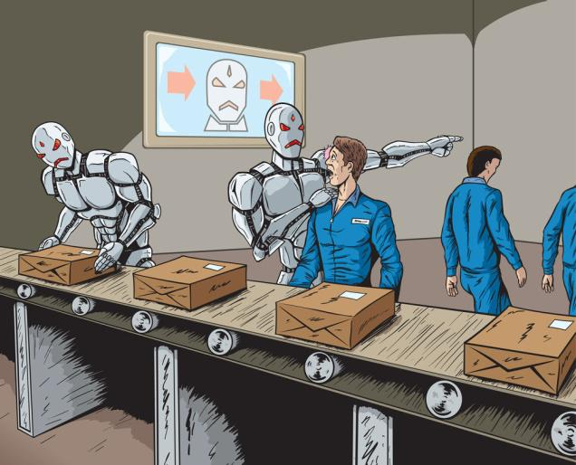
What can trigger Global Economic Disorder in the next few years?
A simultaneous arrival of these socio-political events
Major Bank Collapse
Trade Wars
Euro Crisis
Source-indianeconomy.net
Cyber War affecting finance & economy
Extreme weather
Massive Migration
Technological Unemployment

Slide 17
The road to Technological Unemployment
By 2030 over 100 job types may disappears. Of 3.5bn people of employment age, well over 1bn may become unemployed (Thomas Frey)
But McKinsey is more optimistic expecting 400-800M people loosing their jobs by 2030 (October 2018 report)
In summary, by 2030:
  About 1,000M people (about 30%) world-wide, mostly in Western Hemisphere may become unemployed for a certain period of time during job/skill transition
  About 500M may become permanently unemployable

Slide 18
Which jobs are most likely to disappear by 2030?
Disruptors→
Tony Czarnecki based on: Thomas Frey - http://www.futuristspeaker.com/business-trends/101-endangered-jobs-by-2030/

Slide 19
Who could act as de facto World Government
Notes:
.

Slide 20
Which country or organisation can minimize Global Economic Disorder and other existential risks?
Global Economic Disorder→

Slide 21
We have already run out of time to create a new Supranational Organization!
A pragmatic solution is to adapt an existing Organization and transform it into a Supranational Organization acting as the World Government
So, who has the best capability to do it?

Slide 22
Which organisation could be the best to act as the World Government to fight existential risks such as Superintelligence or Global Disorder?

Slide 23
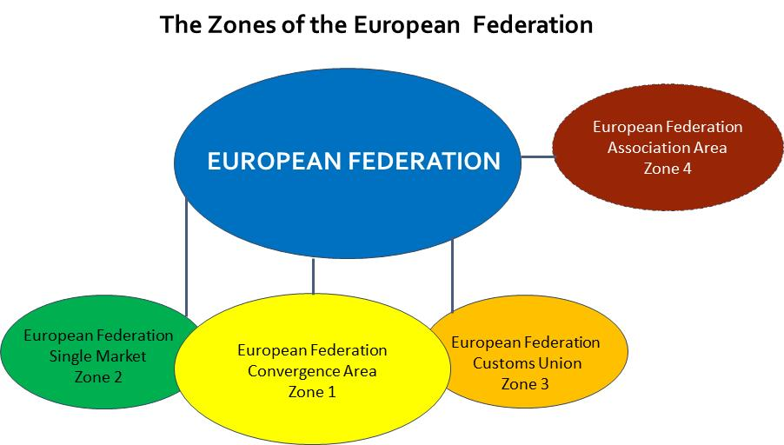

Slide 24
The implementation timeline for converting the EU into the European Federation
European Federation Progressively Enlarged
Eurozone collapses and is shrunk to core members. EU dissolves.
European Federation created with no Zones
EU split into European Federation and ‘Leftover’ Zone
Single EU Foreign Minister
Replacing National FM
EU Army Created and Re-joins NATO
as a Single Member
Scenario 2: The European Union collapses or makes a chaotic transition into the European Federation
EU or EF Global Wealth Redistribution Fund Created
Common Eurozone Budget
EF Global Welfare State Operational
Scenario 4: Step-by-step, under pressure, transition of the European Union into the European Federation
European Federation created with 4 Zones
New European Federation Constitution Ratification Process
Constitutional Convention prepares a New Constitution
Defining Universal Values and Responsibilities of Humanity
The EU Conversion Programme Started With Agreed Principles for Federation
Scenario 5: Pre-planned, orderly transition of
the European Union into the European Federation
2019 | 2020 | 2021 | 2022 | 2023 | 2024 | 2025 | 2026 | 2027 | 2028 | 2029 | 2030 | 2031 | 2032 | 2033 | 2034 | 2035 | 2036 | 2037 | 2038 | 2039 | 2040 and beyond

Slide 25
End of PART 1

