Slide 1
…where Business Sustainability
makes good business sense
Business Sustainability in the age of exponential change
Part 2
How can we achieve global economic sustainability?
Tony Czarnecki
Managing Partner, Sustensis
www.sustensis.co.uk
London, 8th November 2018

Slide 2
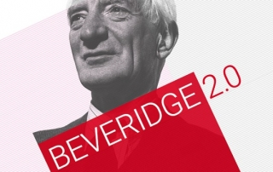
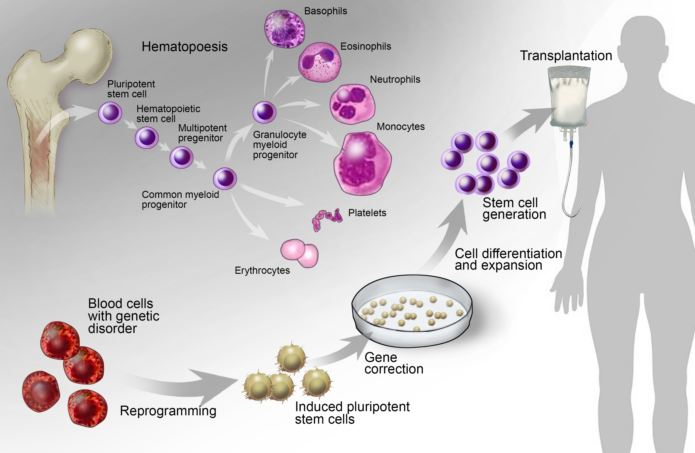
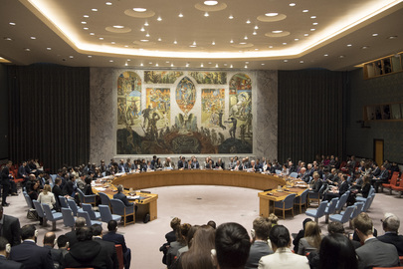
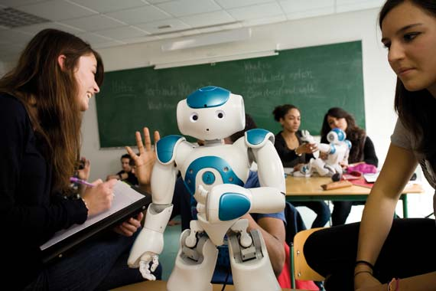
The benefits of Superintelligence: living in the world of abundance
Super Welfare State
Regenerative medicine
New democracy, politics and the end of global wars!
Education
Enabling expansion
to other planets

Slide 3
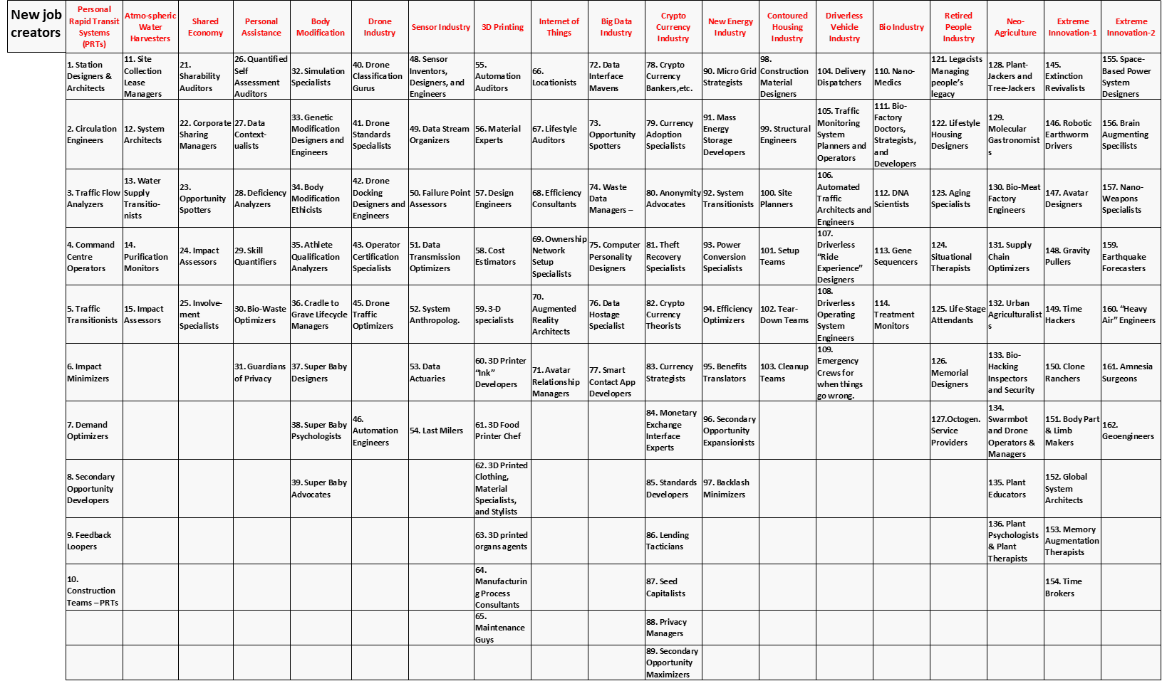
Over 160 new skills in 2030 but what does it mean?

Slide 4
Over 160 new skills in 2030 but what does it mean?
Change in occupations across sectors and regions
Most of new skills will be ‘soft’ and require high education level e.g. bio-meat factory engineers, memory augmentation specialists or super baby designers
Some soft skills will be low-level education e.g. home carers
Partial automation will require co-working with robots
New jobs may pay less e.g. Ford $8 for robots, $25 for workers

Slide 5
SOME VERY GOOD NEWS!
GDP will rise much faster than most economists or organizations e.g. OECD, predict (2.5 – 3.5%) – result of exponential change. E.g. McKinsey’s October 2018 report estimates 1.2% additional GDP growth annually by 2030

Slide 6
What would be the reasons behind such a fast GDP growth?
If Moore’s law continues for the next 15 years, then by 2030 the technology would be about 1,000 times more efficient
Therefore, the global GDP will grow much faster and will double not in 20 years but in about a decade

Slide 7
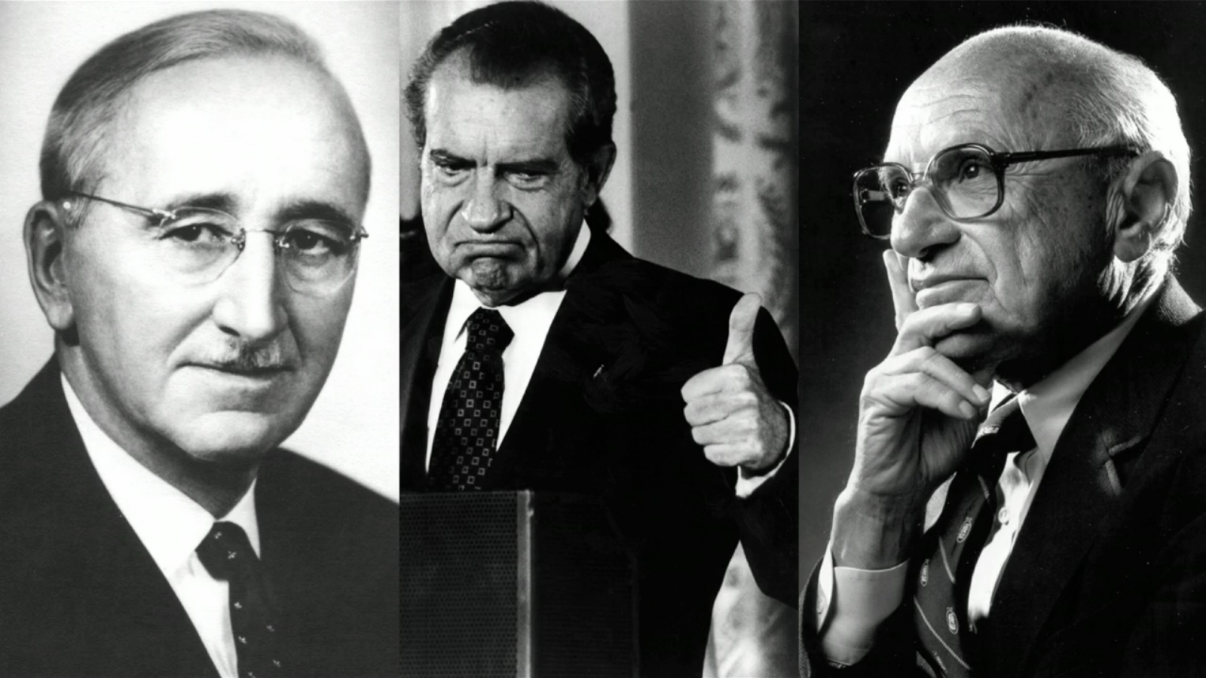
Introduce Universal Basic Income (UBI)
The unlikely proponents of UBI
Frederick Hayek Richard Nixon Milton Friedman

Slide 8
An example for an OECD country - the UBI Proposals in the UK

Slide 9
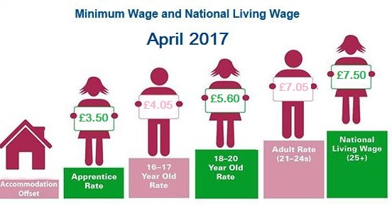
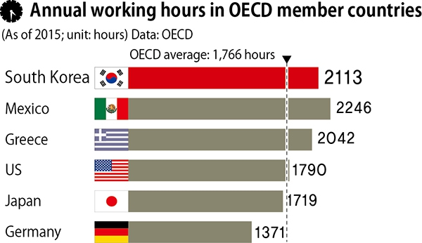
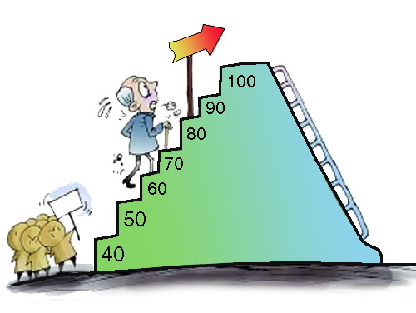
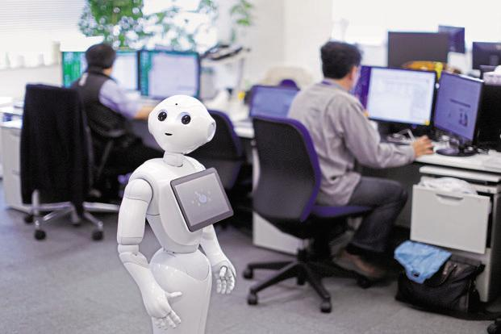
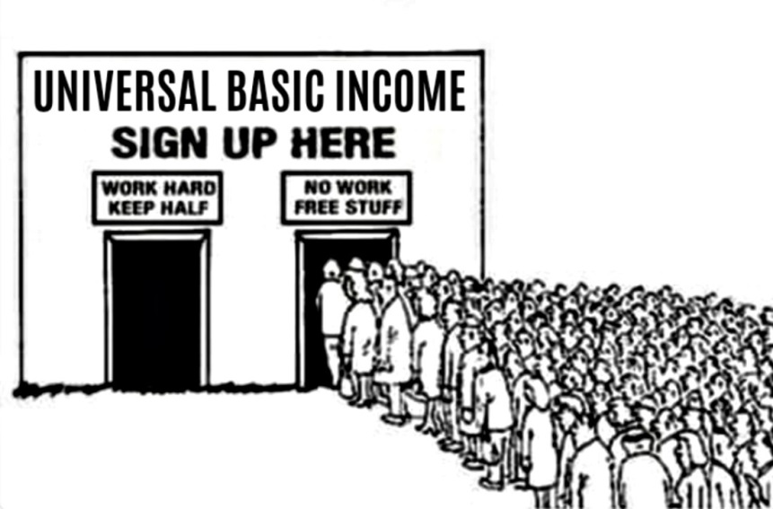
Solutions to minimize the negative impact of AI on the labour market
https://www.cambridgenetwork.co.uk/news/april-2017-national-minimum-wage-and-national-living-wage/
Increase living wage
Cut down working hours
Flexible retirement age
Redesign jobs for sharing, incl. robots
Introduce UBI early and combine it with large scale social engagement programmes
Coaching in ‘life skills’
Personal Life Mentor

Slide 10
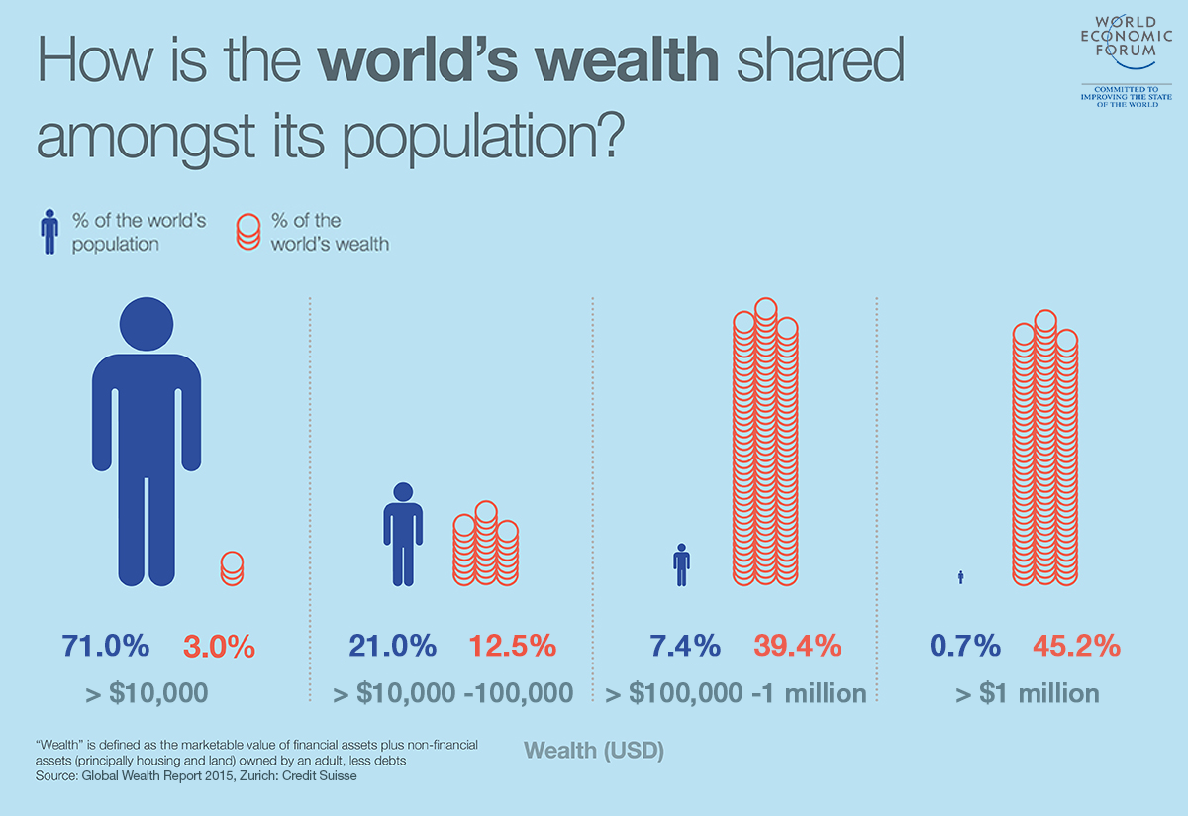
1% of the world’s population owns half of the world’s wealth
1% of the world’s population owns half of the world’s wealth

Slide 11
Global programme of economic and social stability
Create Global Wealth Redistribution Fund (GWRF) - each country’s contribution starts at 0.7% GDP, progressively rising to 2% in 2030
If started now, GWRF annual new funds would reach about $1 trillion in 2030
Redistribute the funds in the EU-style Cohesion Programme, where countries below 90% of average GDP/head receive help through closely monitored projects
Recipient countries additionally contribute about 15% of the value of the project
Positive side-effect – significant boost for the world economy (converting consumption into investment)
Large scale migration or even migration wars would be avoided

Slide 12
End of PART 2

