Slide 1
…where Business Sustainability
makes good business sense
Business Sustainability in the age of exponential change
PART 3
The company of the future and the case for sustainable business
Tony Czarnecki
Managing Partner, Sustensis
www.sustensis.co.uk
London, 8th November 2018

Slide 2
List of oldest companies

Slide 3
Which are the oldest UK companies?
886 - Royal Mint,mint
953 - The Bingley’s Arm, pub
1535 - R J Balson and Sons, butchers
1541 - John Brooke and Sons Holdings Ltd, fashion
1675 - Morning Foods, finest oats
1856 - Burberry, fashion
1864 - John Lewis, department store, retailer
1921 - Scott Bader, synthetic resins – the first Commonwealth company
But in the future, it will be more difficult even for the finest companies to sustain their business. Here is why…

Slide 4
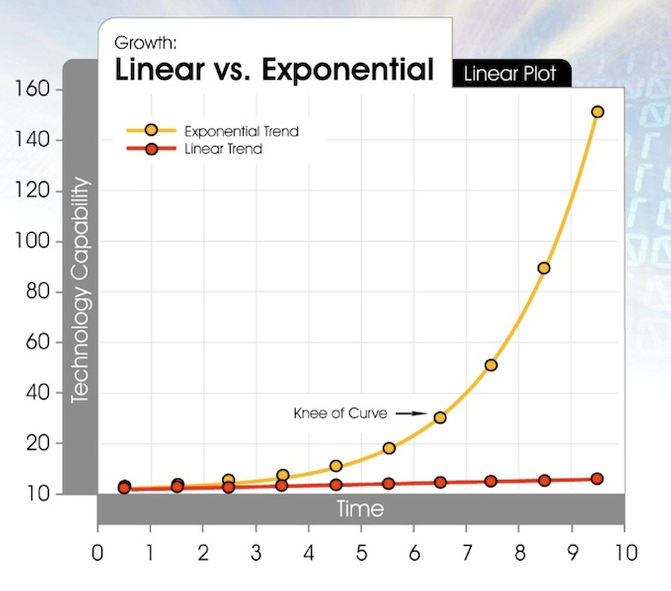
Pace of change is becoming nearly exponential
Heraclitus - Panta Rhei – “No man ever steps in the same river twice”
A simple puzzle
30 steps linear vs. 30 steps exponential
Examples:
Processor speed (18 months)
Genome sequencing
Bio-meat production
Autonomous driving
Knowledge
Source: “ Singularity is Near” (Kurzweil, 2006)
So, what should be the features of a Sustainable Company of the future?

Slide 5
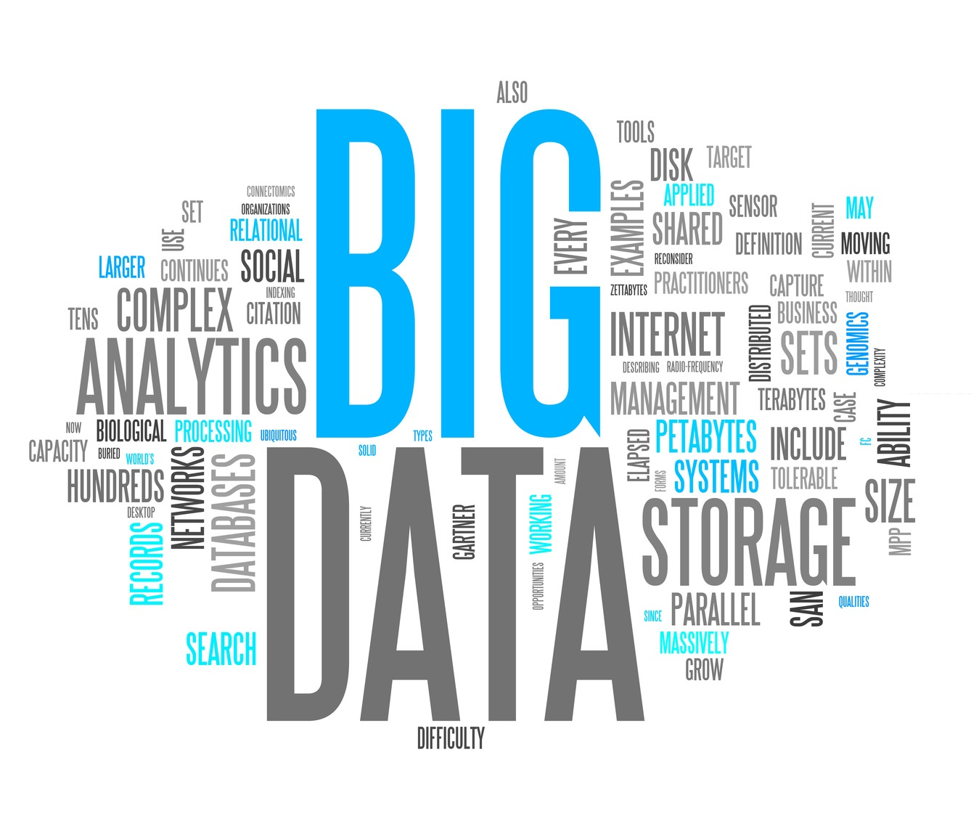
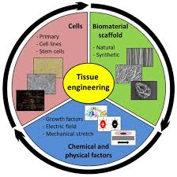
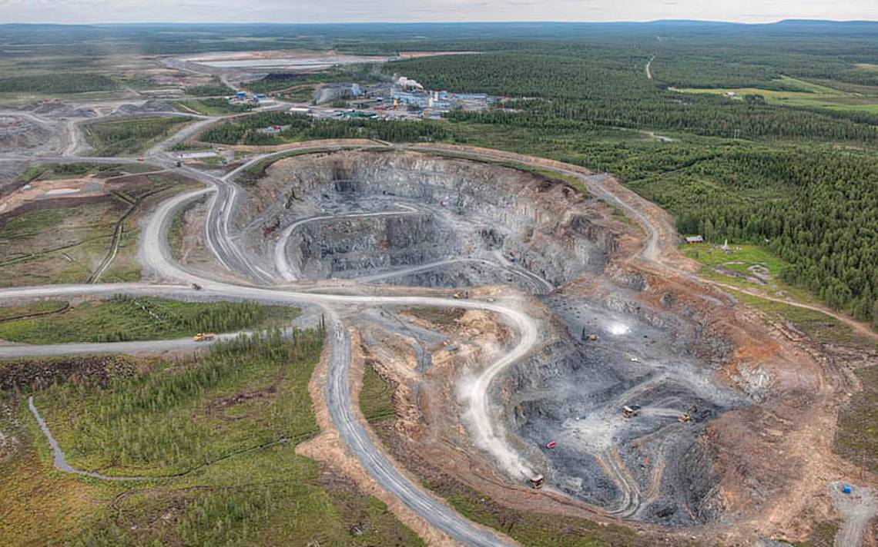
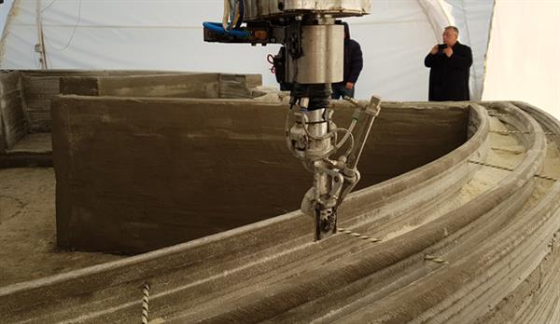
Which industries will change significantly in the next decade?
AI (Virtual and Augmented Reality, Robotics)
IT (Big Data, Cloud , Quantum computing)
Energy production and storage
Chemicals and Materials
Fully robotized Mining and Material Extraction
3D Printing (houses, body organs)
Engineering and Construction (Nano, self-replication robots)

Slide 6
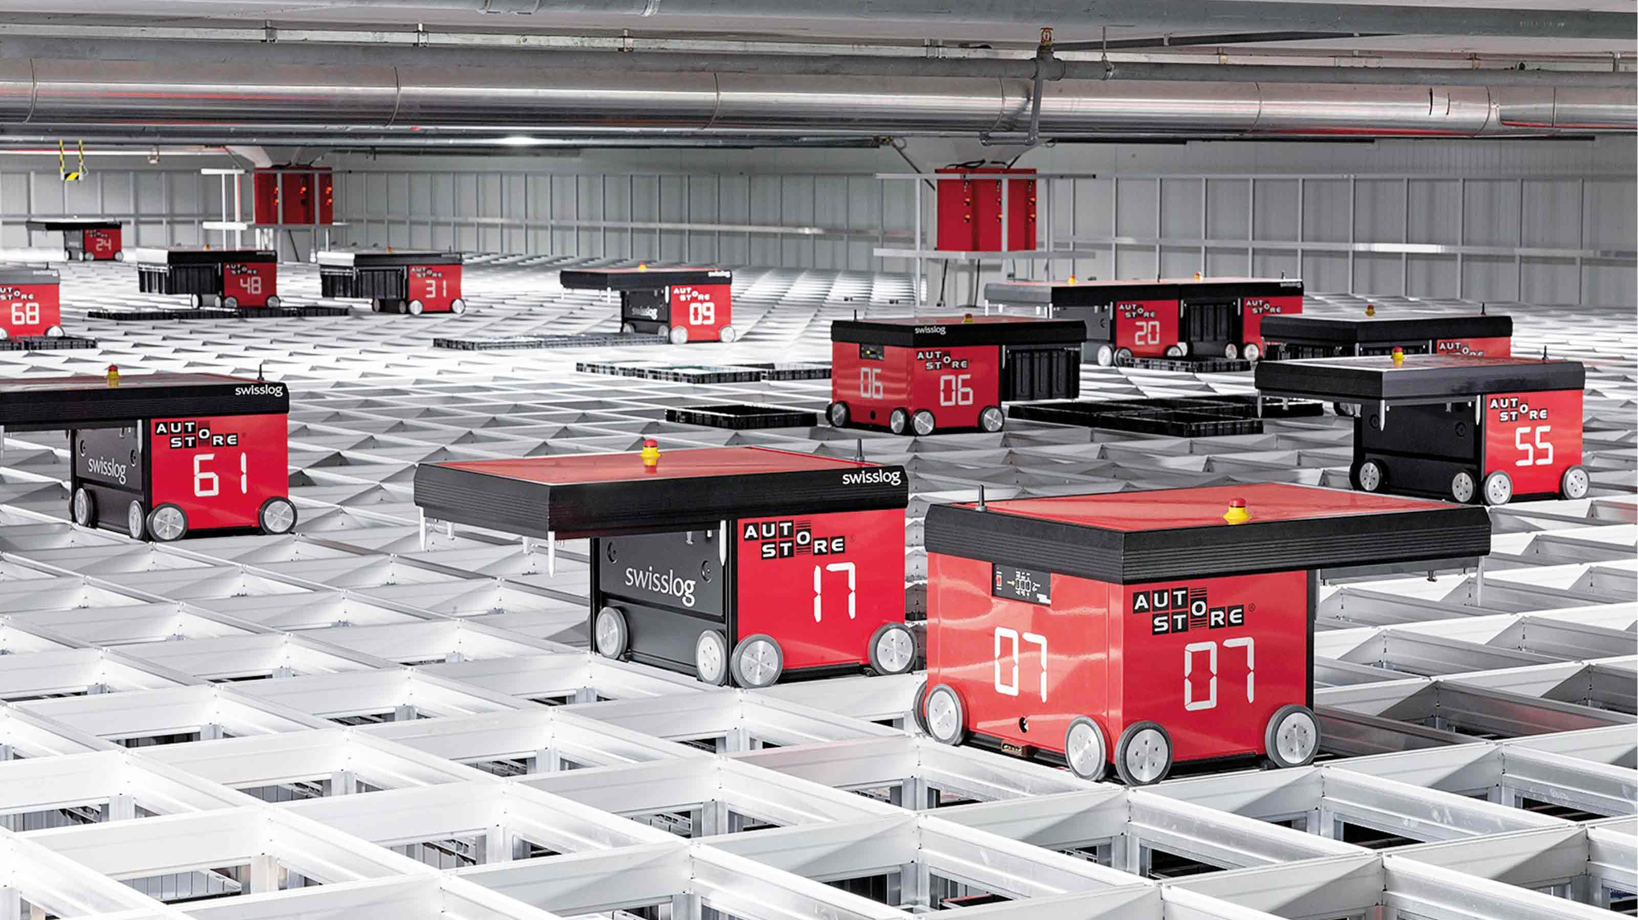
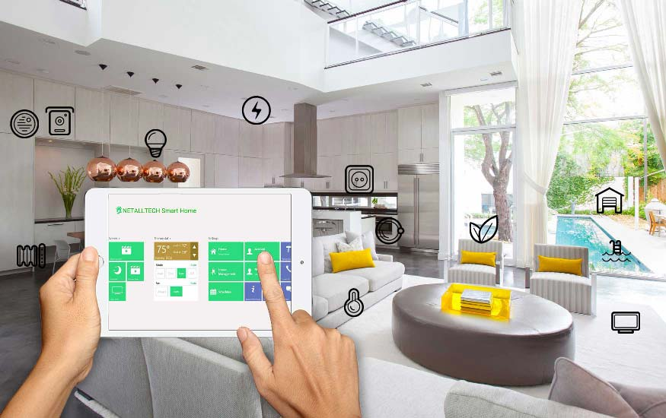
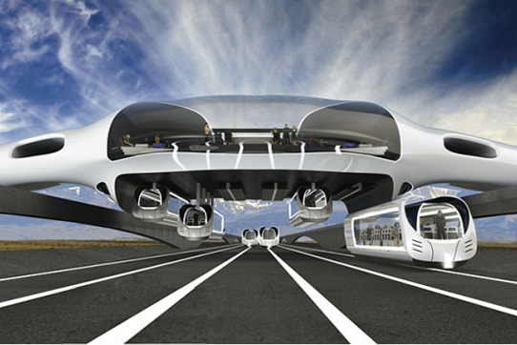
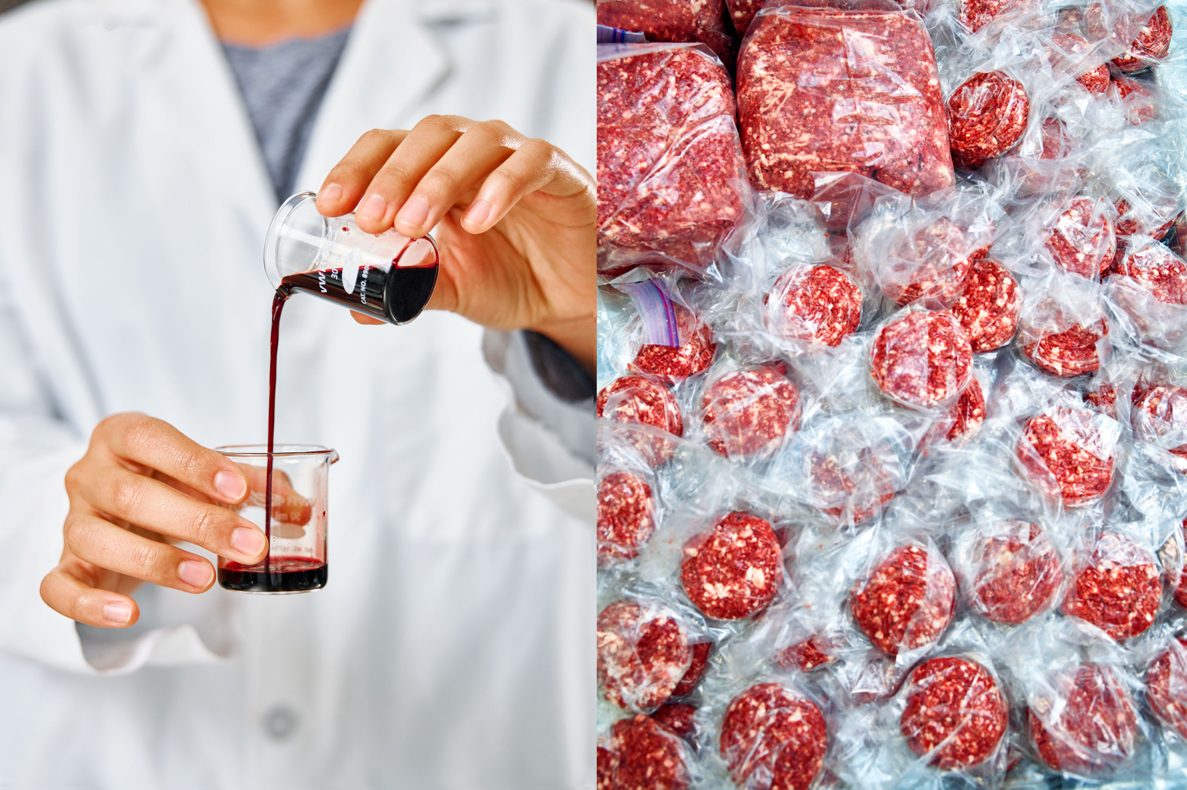
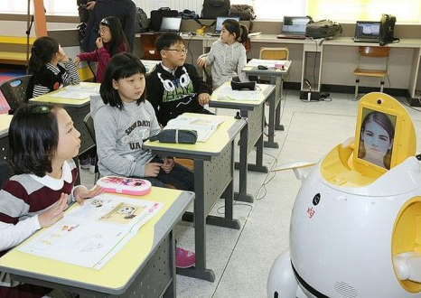
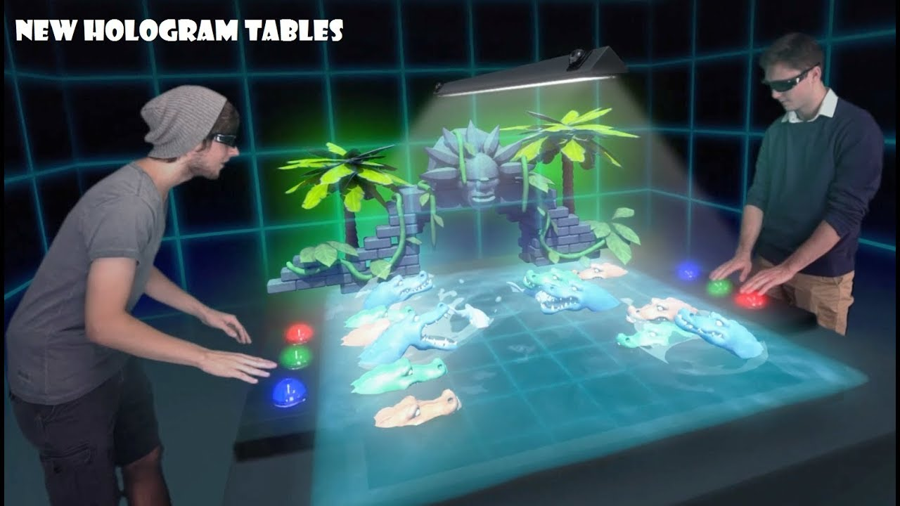
Which industries will change significantly in the next decade?
Retail & Logistics
Connected Home and Living (IoT)
Life Sciences (Healthcare, Genomics, Pharma, Reconstructive med.)
Transportation
Agriculture and Food
Education (Teacher + AI Assistant)
Banking & Finance
Entertainment

Slide 7
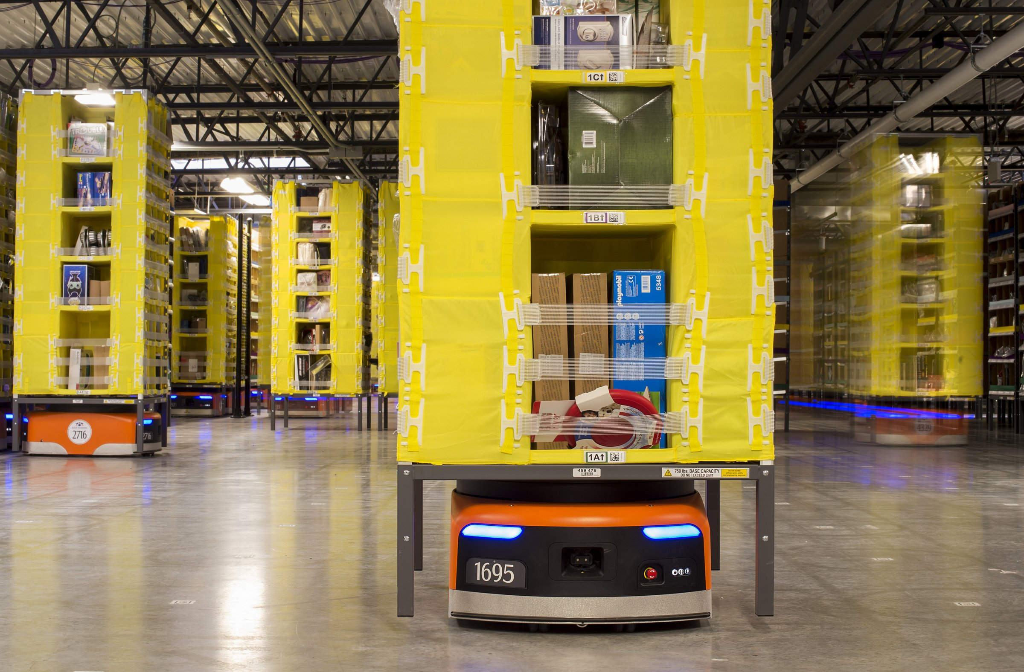
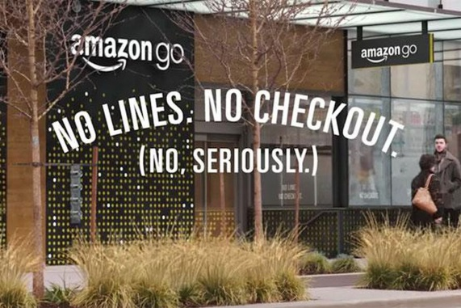
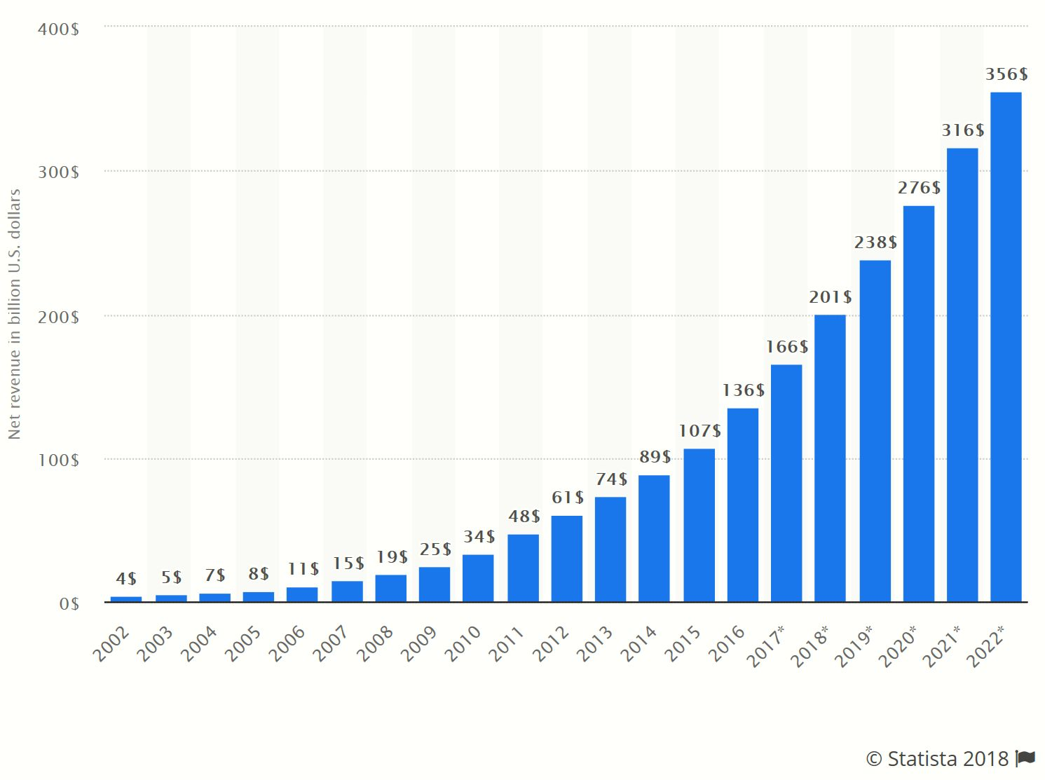
A disruptive super-company: What can we learn from Amazon?
Supreme customer experience; cheap capital
From books to anything: Some of Amazon’s top suppliers
Utmost efficiency
Amazon’s Revenue Growth (20% p.a.)
Notes:
My interest in UBI goes two years back when I had a presentation here on “Real world policy changes for a radically better future”, where the subject of UBI was very prominent. It became so important to me that I dedicated to it a whole chapter in my new book “Who could save Humanity from Superintelligence?” Why have I put that subject of UBI in the context of the most advanced form of Artificial Intelligence?
This is the question I would like to answer in this presentation. Its main body will be the rationale for advancing UBI implementation and seeing it as a start to an indefinite process leading us to the time where most of us will be able to sustain ourselves, albeit at a minimum level, even if not working at all. This will also entail social consequences impacting us all.

Slide 8
The lesson from Amazon
Focus on revenue (20% annual growth over 20 years - $200bn now) and scale, not profit
Focus on customer experience (value) – they come first, rather than advertisements (like Google)
Amazon loses $5.25 on every kindle hardware Source: https://www.youtube.com/watch?v=UyohSu-Ft_U
Extensive use of AI and patented algorithms
An amazing, on the fly alternative products comparison (both Amazon’s and sponsored)
Gathering of information about a customer’s buying preferences and needs
Preventing checking competitors products if its Wi-Fi is used (think about Amazon phone!)
Most innovative supply chain company
Tens of thousands of suppliers on Just In Time (2-hours) inward supply
Outsourcing Inventory Management - 53% of inventory from third-party sellers (Statista)
Insourcing Logistics, supported by Amazon drivers
Different warehouses for different products and delivery options near large cities (70 in US)
Five categories of warehouses (books, full pallet, high demand, irregular shapes and random)
100,000 robots in warehouses (bots)
2005: Prime 2-day delivery, today Prime-Now 2-hours) https://www.thebalancesmb.com/how-amazon-is-changing-supply-chain-management-4155324

Slide 9
Which industries will change significantly in the next decade?
Artificial Intelligence (AI leading to Superintelligence, Virtual Reality and Augmented Reality with holograms, Robotics)
IT (Big Data Analytics, Cloud Comp., Quantum computing & encryption, Online B2B/B2C, Wireless comms, Cybersecurity)
Energy (Solar, wind, tidal, gravitational, from waste, Nuclear Fission and Nuclear Fusion, Energy Storage)
Mining and resources extraction (Fully robotised mines, Super energy efficient resources extraction (e.g. using bacteria)
Chemicals and Materials (Nanomaterials, biomaterials)
Engineering and Construction (3D printing, Self-assembly and self-repair, Nanotechnology, Multipurpose objects)
3D Printing (Construction and housing, Robotics, Regenerative medicine)
Retail and Logistics (Automated warehousing and distribution, staff-less shopping)
Connected Home and Living (Internet of Things -IoT)
Life Sciences (Healthcare, Genomics, Pharma, Reconstructive med., Regenerative med., 24-h Diagnostics (med. wearables)
Transportation (Driverless transport, Urban logistics, Drones, Space travel, Mobile robotics (factories and warehouses)
Agriculture and Food (Bio-meat production, Hydroponic soil-less vegetable growing, Non-perishable food)
Education (Personal AI tutors, Human class-room mentors, State-sponsored lie-long Learning
Banking and finance (Mobile Payments, Peer-to- Peer lending, Cryptocurrencies)
Entertainment
In 2030 you will only need about 20 companies of the future size of Amazon ($1.5 tr) to produce the GDP of the whole USA

Slide 10
What may be the consequence of the ‘amazonization’ of economy?
Amazon’s incessant drive towards world’s domination
Shareholders come third, after customers and employees
They do not mind losing money (profited in only 2 quarters), hence the cheapest capital
They wait for super dividend at some stage
Amazon has followers – Musk with Tesla and X-Space, Uber, Netflix, even Walmart
The future government’s legislation, e.g. limiting a company’s size, could lead to a mega crash and unravel a gigantic pyramid scheme
This could immediately affect similar companies like Alphabet, Facebook or Walmart significantly increasing …

Slide 11
The lesson from Amazon: What Business of the Future may look like?
In 2030 you will only need about 20 companies of the future size of Amazon ($1.5 tr) to produce the GDP of the whole USA
“The factory of the future will have only two employees:
a man and a dog. The man will be there to feed the dog.
The dog will be there to keep the man from touching the machines”
Source: Wren Bennis

Slide 12
What is Business Sustainability?
At a national level … “sustainable development fulfils the needs of the present without limiting the potential for meeting the needs of future generations“ (Brundtland 1987).
At a company level …“Business Sustainability fulfils economic, social and environmental needs of the present stakeholders without limiting the potential for meeting the needs of the future stakeholders”
Sustainability requires the balancing of the interests of all stakeholders

Slide 13
Business case for a sustainable company
Growth of share value in 50 years for $1 invested in 1926
21 “Sustainable” Companies
(American Express, IBM,
Boeing, Mariott)
$6,356
Comparison
Companies
(GM, Nabisco, Chase)
$991
General Stock
$415
“Build to Last: Stanford University

Slide 14
Net performance improvement in companies applying Business Sustainability
50
45
40
35
30
25
Performance
Percent
20
Improvement %
Market
15
Capitalization
10
5
0
1
2
3
4
5
6
7
8
9
10
Years
1996-2009 Sustensis Ltd, London
Definition: Companies practicing Business Sustainability are deemed to be those that have been applying strict CSR rules, focused on long-term growth and having balanced share of profits with key stakeholder groups over long-term.
Source 1: Market capitalization – Sandra Waddock, Boston College 2003 (5% p.a); Source 2: Built to last: 1,600% over 50 years (about 3% p.a.); Source 3: Performance improvement: Governance Metrics International 2003 (Corporate governance alone boosts perf. up to 20% in 3 years. Aggregate calculation and graph by Sustensis Ltd.

Slide 15
Examples of sustainable business
The share value of the USA companies that were “vision-led” and investing for long-term sustainable development outperformed in a 50-year period the general stock companies 16 times (Source: Stanford University –Build to Last Report)
Dow Jones Sustainability Global Index outperformed Dow Jones Global Index between 1993-2000 by 44% (source: Swiss Asset Management 2001 and P.Cerin & P. Dobers – Eco-Management 2001)
Every 8th dollar in the USA is invested in CSD-style assets (about $2.2 trillion in 1999 - 13% of the market) (source: Social Style Investment Forum 2000)
Visionary, sustainable companies can have a premium of over 5% over non-visionary companies on the share price alone (prof. Sandra Waddock Boston Univ. 2001)
Good corporate governance, key element of sustainable growth, can on its own significantly boost performance (20% faster growth in best European companies over 3 years (source: Governance Metrics International 2003)
Growth in CSD-style investment is about 40% per annum (16% for other stock) (source: Social Style Investment Forum 2000)

Slide 16
Further examples of sustainable business
In 2000 there were 226 SBS funds worldwide of which 81 (40%) in USA, 47 in UK, 20%), 26 in Sweden and 22 in Canada (source: University of Lunenberg 2000)
The growth rate in investment in the USA into CSR/CSD funds was 1.5 times faster than in general stock (source: Nelson Directory of Investment Management 2001)
Investments in socially screened mutual funds fell during the first nine months of 2001 by only 54%, (94% the rest of the market) (source: Social Investment Forum Foundation and Social Investment Forum, 2002)
Ethical behaviour/reputation, one of key factors of sustainability, may be a major intangible company asset (e.g. about 96% of Coca Cola market capitalization are "intangibles", of which a major part is derived from that company’s reputation) (source: RSA Journal Apr 2003)

Slide 17
Shareholders and stakeholders – what’s the difference?
Shareholders hold shares, not assets – a subset of stakeholders
Why are shareholders so privileged?
Historically – lack of free capital
Today – abundance of capital – human capital or scarce resources make more difference to success than cheaper capital
Shareholders/investors have less trust in the management of their capital because they have less control – SE instead of private capital
Long-term, stakeholder economies generate better value: e.g. France’s GDP (4th) productivity in 1995 only 2% lower than USA (3rd), but wages/employee 10% higher, shortest working week, longest holidays (Belgium – 1st Italy 2nd) (World Competitiveness Report.1996)
Stakeholder focused companies generate between 3-5% higher market value per annum and about 4% higher performance. Shareholders/investors also get better return in those companies than in short-term based enterprises

Slide 18
The key feature of sustainable companies in the future
Orientate companies around ‘a higher purpose’ as the main indirect route to higher profits (Elon Musk, Jeff Bezos)
Focus on stakeholders equally rather than just shareholders
Determine the type of a company you want to be and trade most effectively with the two other types of companies, i.e.
Platform-based – may be constrained by government legislation – huge scale
Outsource service providers – huge scale
Product and service providers (including financial sector and commodities)
Deliver company mission in a way that it realizes full potential of technological, human and capital resources
See opportunities beyond current capital constraints thus increasing turnover rather than profit (Amazon)
Run a company with top efficiency & innovation while re-orientating it to new business type (Amazon's move into Pharma)
Hire entrepreneur-type employees who put higher value on learning new skills & experimenting than moving up the hierarchy
Provide the best customer experience (price, delivery, communication) by:
Scaling up and providing customer intimacy, including speed of delivery
Putting the right-skilled people (experts in the field) in the top managerial role
Combining big data with human front-line intelligence to sell both products and services seamlessly
Creating expert teams to spread best practice in the company
Enabling continuous employee coaching and getting feedback in real time
Self-organized and self-managed teams with no permanent bosses, including external experts (networking) to achieve mission critical projects
Significantly expanding the outsourcing and enabling higher-density robotization, e.g. Auto Store at individual transaction level

Slide 19
End of Part 3

