Slide 1
Work and life style in the age of Superintelligence
Tony Czarnecki
Managing Partner, Sustensis
www.sustensis.co.uk
London, 31st October 2018

Slide 2
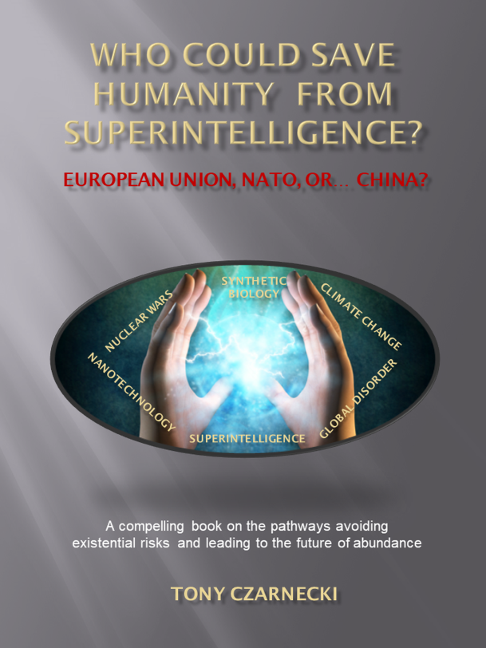
My AI journey
Business Sustainability: “How can companies survive ‘for ever’”
Adapting the metaphor
© Copyright 2012-2018 Creatively United for the Planet Society
“How can Humanity survive ‘for ever’”
It’s about Humanity’s transition to its coexistence with Superintelligence
Notes:
My interest in UBI goes two years back when I had a presentation here on “Real world policy changes for a radically better future”, where the subject of UBI was very prominent. It became so important to me that I dedicated to it a whole chapter in my new book “Who could save Humanity from Superintelligence?” Why have I put that subject of UBI in the context of the most advanced form of Artificial Intelligence?
This is the question I would like to answer in this presentation. Its main body will be the rationale for advancing UBI implementation and seeing it as a start to an indefinite process leading us to the time where most of us will be able to sustain ourselves, albeit at a minimum level, even if not working at all. This will also entail social consequences impacting us all.

Slide 3
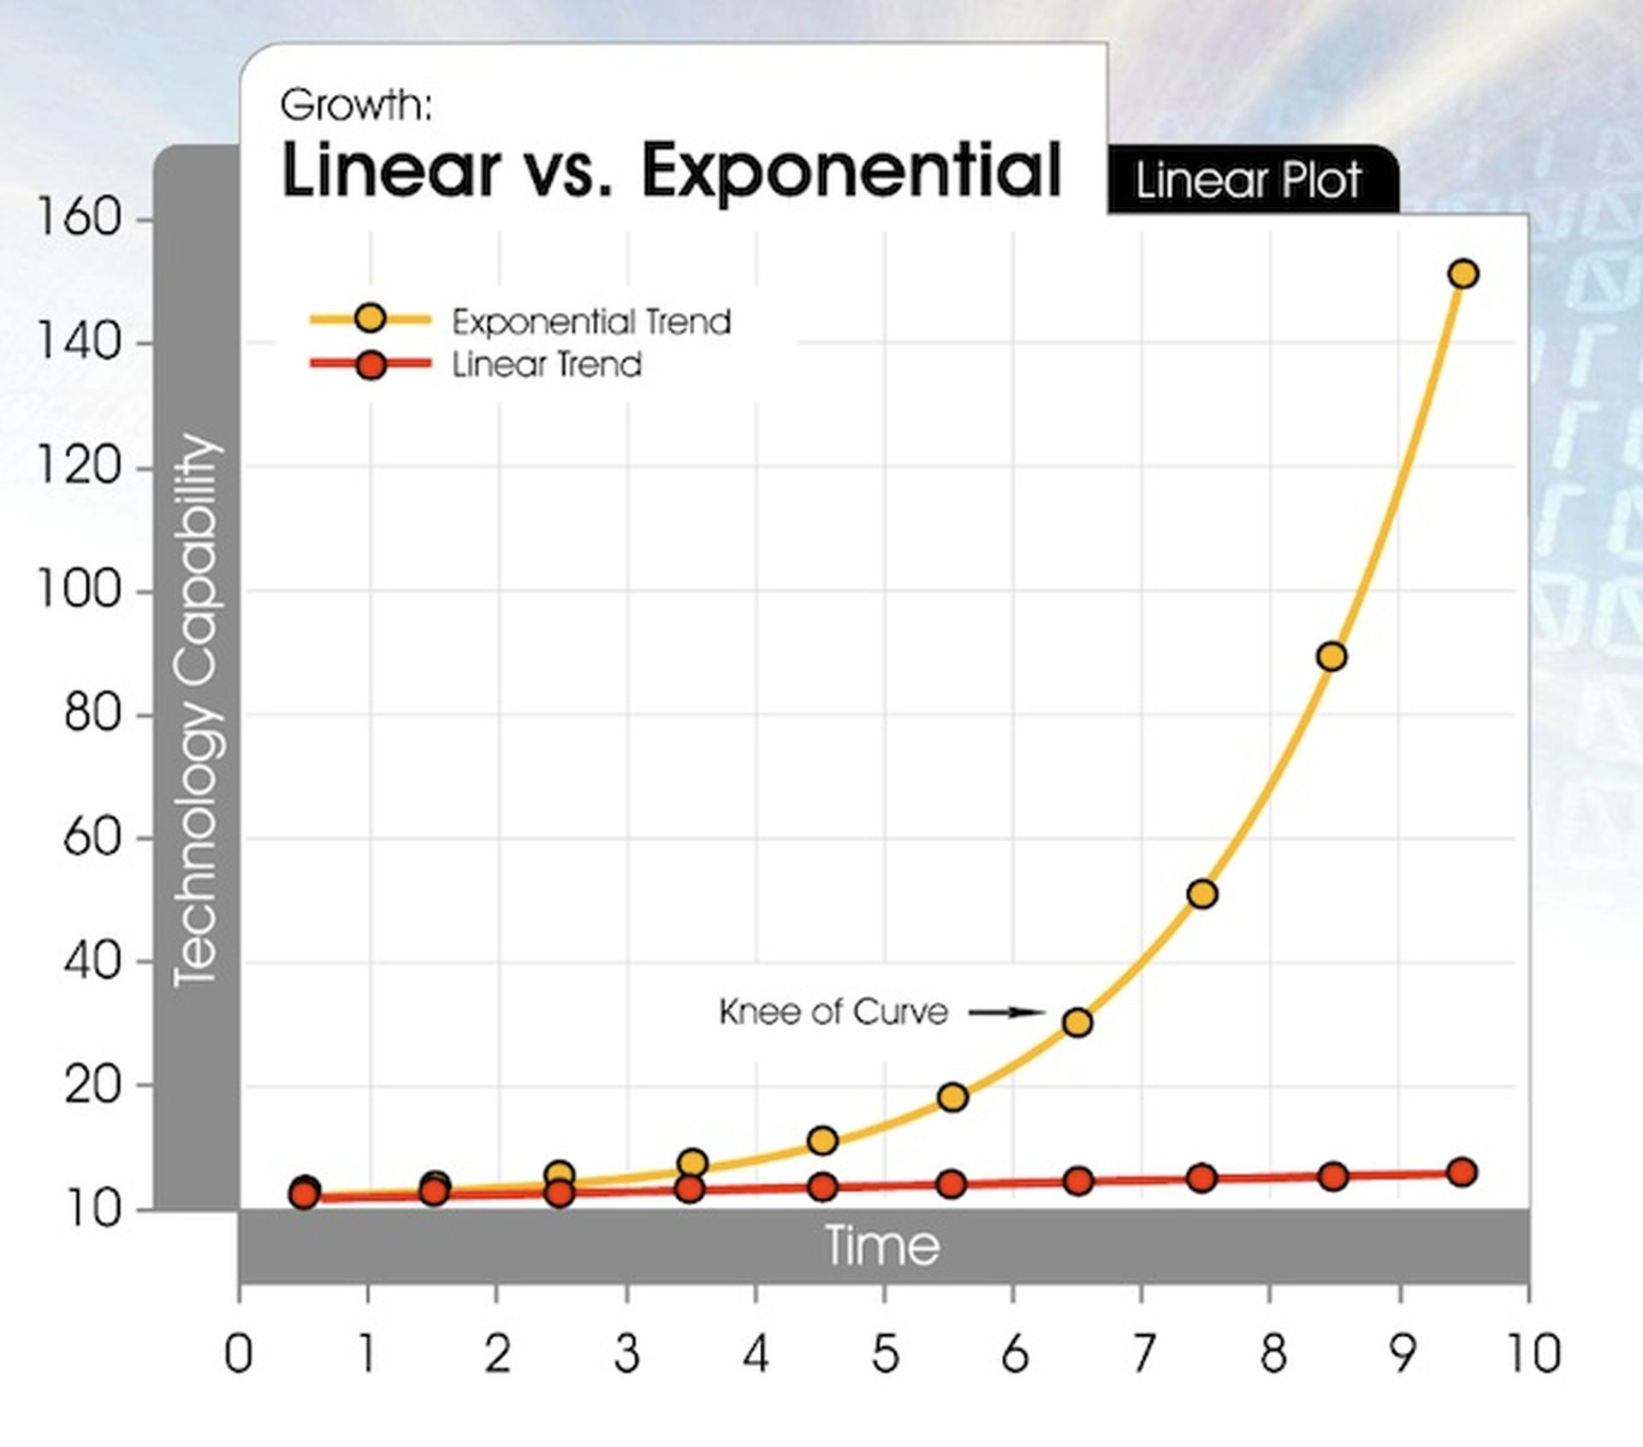
What is exponential change?
A simple puzzle
30 steps linear vs. 30 steps exponential
Examples:
Processor speed (18 months)
Genome sequencing
Artificial meat production
Autonomous driving
Knowledge
Source: “ Singularity is Near” (Kurzweil, 2006)
Notes:
This template can be used as a starter file to give updates for project milestones.
Sections
Right-click on a slide to add sections. Sections can help to organize your slides or facilitate collaboration between multiple authors.
Notes
Use the Notes section for delivery notes or to provide additional details for the audience. View these notes in Presentation View during your presentation.
Keep in mind the font size (important for accessibility, visibility, videotaping, and online production)
Coordinated colors
Pay particular attention to the graphs, charts, and text boxes.
Consider that attendees will print in black and white or grayscale. Run a test print to make sure your colors work when printed in pure black and white and grayscale.
graphics, tables, and graphs
Keep it simple: If possible, use consistent, non-distracting styles and colors.
Label all graphs and tables.

Slide 4
Living in the age of exponential change
Notes:
This template can be used as a starter file to give updates for project milestones.
Sections
Right-click on a slide to add sections. Sections can help to organize your slides or facilitate collaboration between multiple authors.
Notes
Use the Notes section for delivery notes or to provide additional details for the audience. View these notes in Presentation View during your presentation.
Keep in mind the font size (important for accessibility, visibility, videotaping, and online production)
Coordinated colors
Pay particular attention to the graphs, charts, and text boxes.
Consider that attendees will print in black and white or grayscale. Run a test print to make sure your colors work when printed in pure black and white and grayscale.
graphics, tables, and graphs
Keep it simple: If possible, use consistent, non-distracting styles and colors.
Label all graphs and tables.

Slide 5
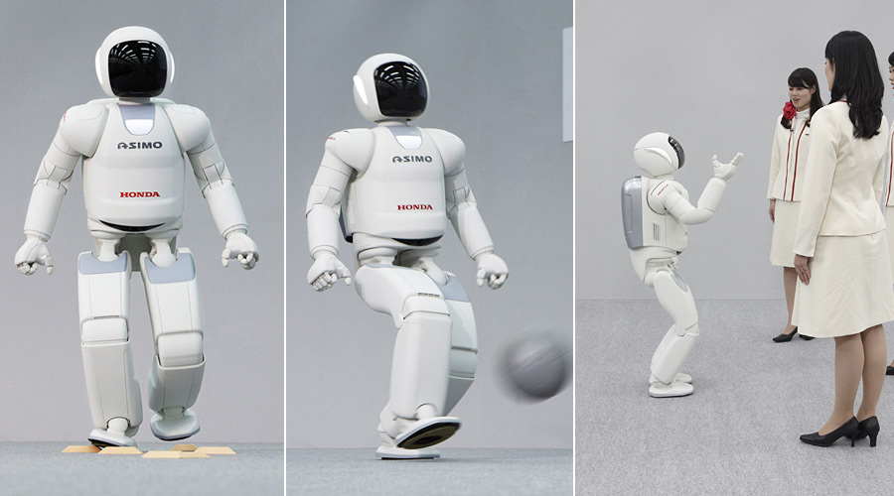
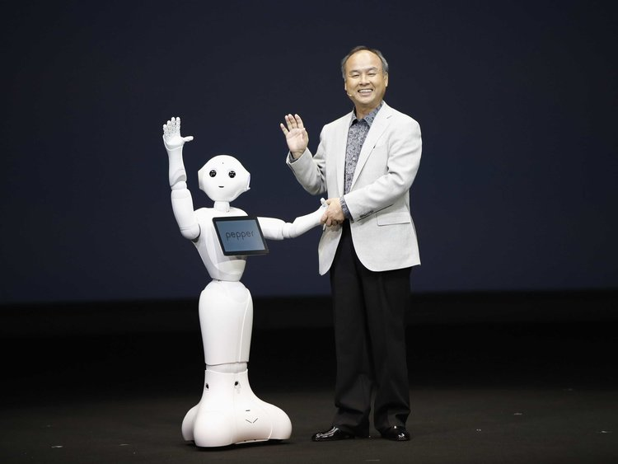
What is Intelligence, AI and Superintelligence?
Intelligence – ability to learn and apply knowledge to change the environment most effectively, i.e. the ability to:
Evaluate and judge
Have abstract thoughts and the ability to reason
Quickly learn from experience
Comprehend complex ideas
To have the capacity for original thought
Information Technology – processing of information using strict, uniquely defined rules
Artificial Intelligence – problem solving through learning using incomplete information e.g.:
AlphaGo Zero
Asimo
Pepper
Notes:
This template can be used as a starter file to give updates for project milestones.
Sections
Right-click on a slide to add sections. Sections can help to organize your slides or facilitate collaboration between multiple authors.
Notes
Use the Notes section for delivery notes or to provide additional details for the audience. View these notes in Presentation View during your presentation.
Keep in mind the font size (important for accessibility, visibility, videotaping, and online production)
Coordinated colors
Pay particular attention to the graphs, charts, and text boxes.
Consider that attendees will print in black and white or grayscale. Run a test print to make sure your colors work when printed in pure black and white and grayscale.
graphics, tables, and graphs
Keep it simple: If possible, use consistent, non-distracting styles and colors.
Label all graphs and tables.

Slide 6
What is Intelligence, AI and Superintelligence?
Intelligence – ability to learn and apply knowledge to change the environment most effectively, i.e. the ability to:
Evaluate and judge
Have abstract thoughts and the ability to reason
Quickly learn from experience
Comprehend complex ideas
To have the capacity for original thought
Information Technology – processing of information using strict, uniquely defined rules
Artificial Intelligence – problem solving through learning using incomplete information, e.g. Alpha-Go, Assimo ($2.5M) or Pepper ($20K)
Immature Superintelligence – Surpasses humans in a specific domain, passes Turing Test, but may behave unpredictably or incorrectly (2029!)
Superintelligence (Artificial General Intelligence) – far exceeding human cognitive ability in any domain (2040-45)
Technological Singularity – the runaway point when Superintelligence develops at an exponential pace (beyond 2045)
Notes:
This template can be used as a starter file to give updates for project milestones.
Sections
Right-click on a slide to add sections. Sections can help to organize your slides or facilitate collaboration between multiple authors.
Notes
Use the Notes section for delivery notes or to provide additional details for the audience. View these notes in Presentation View during your presentation.
Keep in mind the font size (important for accessibility, visibility, videotaping, and online production)
Coordinated colors
Pay particular attention to the graphs, charts, and text boxes.
Consider that attendees will print in black and white or grayscale. Run a test print to make sure your colors work when printed in pure black and white and grayscale.
graphics, tables, and graphs
Keep it simple: If possible, use consistent, non-distracting styles and colors.
Label all graphs and tables.

Slide 7
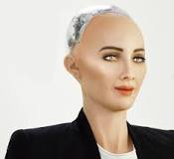
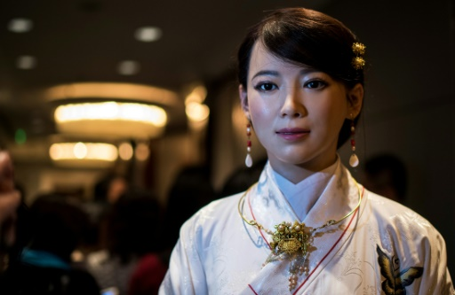
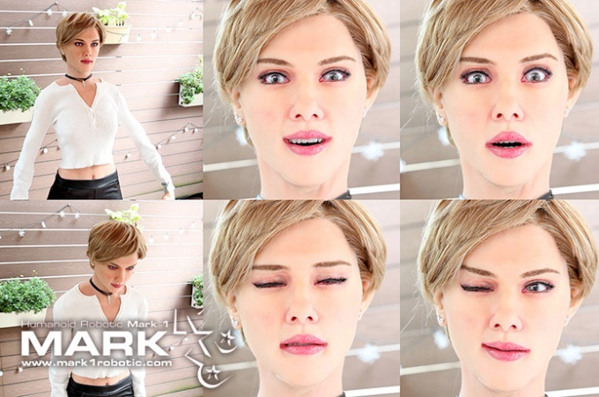
What will Superintelligence look like?
How many Superintelligences? Initially many – competing in a cyber war. But ultimately just one – local agents in a networked system like the Internet web
Hardware? Distributed processors (Google – over 1M computers)
Form? Local networked computers quite often in a human form, indistinguishable from humans
Sophia: Most intelligent
Jia-Jia: Most human-like
Mark 1: Best facial expression
And then you have Alexa…
But isn’t Superintelligence – another existential risk for Humanity?
Notes:
This template can be used as a starter file to give updates for project milestones.
Sections
Right-click on a slide to add sections. Sections can help to organize your slides or facilitate collaboration between multiple authors.
Notes
Use the Notes section for delivery notes or to provide additional details for the audience. View these notes in Presentation View during your presentation.
Keep in mind the font size (important for accessibility, visibility, videotaping, and online production)
Coordinated colors
Pay particular attention to the graphs, charts, and text boxes.
Consider that attendees will print in black and white or grayscale. Run a test print to make sure your colors work when printed in pure black and white and grayscale.
graphics, tables, and graphs
Keep it simple: If possible, use consistent, non-distracting styles and colors.
Label all graphs and tables.

Slide 8
What harm can an unfriendly Superintelligence do to us?
Preventing humans from using resources
Subversion of governmental and private organizations
Constructing a total surveillance state
Total restriction of freedom of movement
Abusing and torturing humans
Eliminating human species by indifferent or violent action
Notes:
This template can be used as a starter file to give updates for project milestones.
Sections
Right-click on a slide to add sections. Sections can help to organize your slides or facilitate collaboration between multiple authors.
Notes
Use the Notes section for delivery notes or to provide additional details for the audience. View these notes in Presentation View during your presentation.
Keep in mind the font size (important for accessibility, visibility, videotaping, and online production)
Coordinated colors
Pay particular attention to the graphs, charts, and text boxes.
Consider that attendees will print in black and white or grayscale. Run a test print to make sure your colors work when printed in pure black and white and grayscale.
graphics, tables, and graphs
Keep it simple: If possible, use consistent, non-distracting styles and colors.
Label all graphs and tables.

Slide 9
What is the compound existential risk for Humanity by 2100?
The Future of Humanity Institute estimates the overall existential risk of human extinction at 20% by 2100
But there are scientists like prof. Martin Rees who calculate the overall risk at 50% in 2050

Slide 10
Why is Superintelligence the top existential risk?
The war of the robots: which AI/Superintelligence will prevail?
Even the immature Superintelligence that could be available by 2030 can be disastrous (power networks, military devices)
The biggest risk of mature Superintelligence is that it may develop a different value system and thus eliminate Humanity as a species

Slide 11
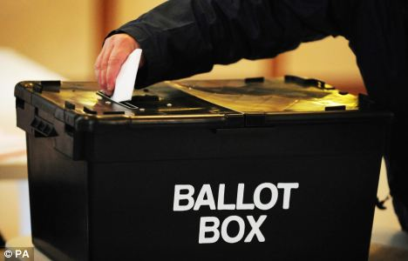
Humanity is defined by its VALUES!
Freedom
Justice
Democracy
But sometimes even Freedom must be restricted to make us safer because there is only one absolute Value …
LIFE!
The risk from Superintelligence is so great that it will require restrictions of Freedom, Sovereignty and redefinition of Democracy based on a new set of Universal Values of Humanity which will need to be transferred to Superintelligence
Notes:
My personal history perhaps explains why values and wider aspects related to politics and the future of Humanity concern me so much.

Slide 12
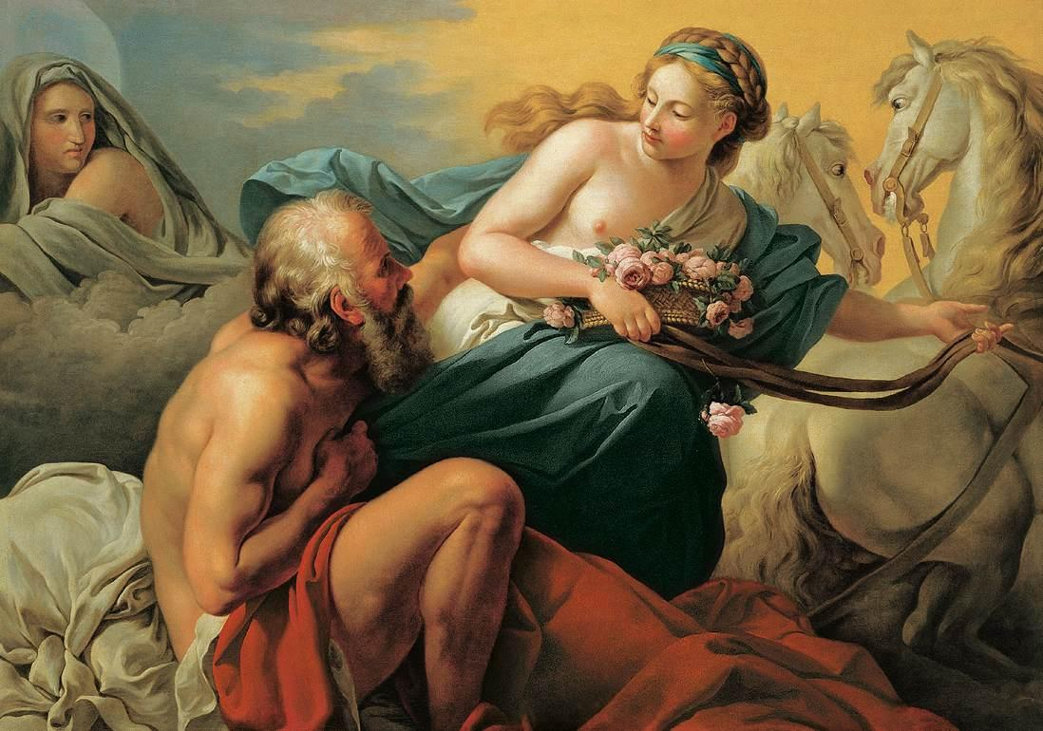
The problem of transfer of our values to Superintelligence
Do what I say is not the same as: DO WHAT I MEAN!
EOS – goddess of dawn
Tithonus - a mere mortal
Immortality is not the same as Youth!
The first law of Isaac Asimov’s DO NO HARM TO A HUMAN may be misinterpreted

Slide 13
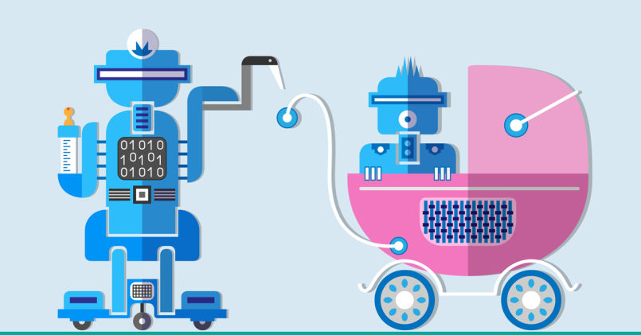
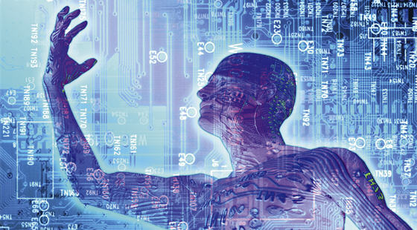
How to minimize the risk of misinterpretation by Superintelligence?
Starting right now
After 2030
Bring up Superintelligence as a child, instilling our values
Transhumanism - uploading the human mind digitally and evolving it into Superintelligence
So, what is being done?
https://sloanreview.mit.edu/article/managing-with-immature-ai/

Slide 14
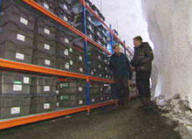
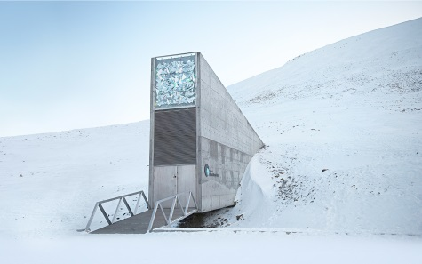
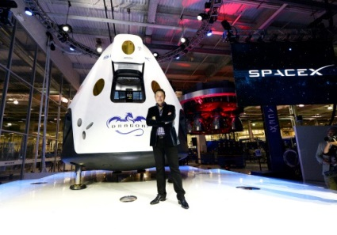
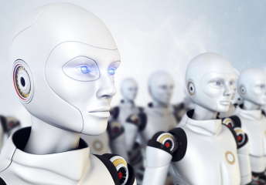
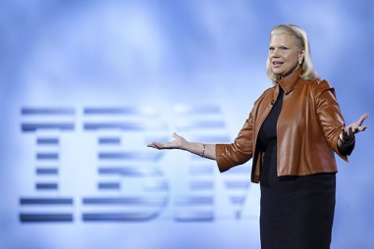
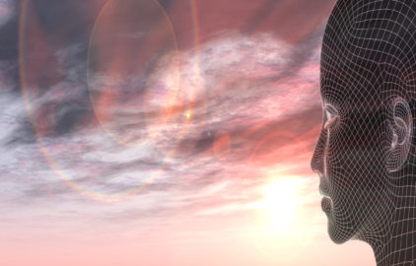
How is the World already trying to mitigate the risks?
The worst case scenario (if civilisation is destroyed)…
The Svalbard Global Seed Vault is a secure seed bank on the Norwegian island of Spitsbergen (started 2006)
The Arctic World Archive will store the world's digital heritage and valuable data (proposed 2 April 2017)
Elon Musk: A Million Humans Could Live on Mars by the 2060s (announced in 2016)
The best case scenario - controlling Superintelligence
Google, Facebook, Amazon, IBM and Microsoft created a new AI partnership to minimize the AI risk and set research and development standards (Oct.2016)
IBM’s CEO Ginni Rometty: In 5 years, Watson A.I. will be behind your every decision, but it will be segmented rather than general AI (Oct. 2016)
23 Asilomar Principles
(January 2017)
But what is the UN?
Notes:
This template can be used as a starter file to give updates for project milestones.
Sections
Right-click on a slide to add sections. Sections can help to organize your slides or facilitate collaboration between multiple authors.
Notes
Use the Notes section for delivery notes or to provide additional details for the audience. View these notes in Presentation View during your presentation.
Keep in mind the font size (important for accessibility, visibility, videotaping, and online production)
Coordinated colors
Pay particular attention to the graphs, charts, and text boxes.
Consider that attendees will print in black and white or grayscale. Run a test print to make sure your colors work when printed in pure black and white and grayscale.
graphics, tables, and graphs
Keep it simple: If possible, use consistent, non-distracting styles and colors.
Label all graphs and tables.

Slide 15
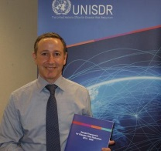
Anyone wanting to improve the situation faces three problems
Existential risks we face require fast action, while the world’s organisations act very slowly Paris Agreement (20 years)
People want more freedom and more control, (think Brexit, Trump) while we need to give up some of our freedoms and national sovereignty to preserve humanity (swarm behaviour)
Most people can’t see beyond tomorrow and act emotionally, while we need to see the big picture and act rationally
UN is the best example of Humanity’s inability to act in a swarm-like fashion
UN: Dr. R. Glasser, the Special Representative of the UN Secretary-General for Disaster Risk Reduction, January 2016)
So, who could take the ultimate responsibility for saving the human species?
Notes:
This template can be used as a starter file to give updates for project milestones.
Sections
Right-click on a slide to add sections. Sections can help to organize your slides or facilitate collaboration between multiple authors.
Notes
Use the Notes section for delivery notes or to provide additional details for the audience. View these notes in Presentation View during your presentation.
Keep in mind the font size (important for accessibility, visibility, videotaping, and online production)
Coordinated colors
Pay particular attention to the graphs, charts, and text boxes.
Consider that attendees will print in black and white or grayscale. Run a test print to make sure your colors work when printed in pure black and white and grayscale.
graphics, tables, and graphs
Keep it simple: If possible, use consistent, non-distracting styles and colors.
Label all graphs and tables.

Slide 16
We have already run out of time to create a new Supranational Organization
A pragmatic solution is to adapt an existing Organization and transform it into a Supranational Organization acting as the World Government
So, who has the best capability to do it?
Notes:
This template can be used as a starter file to give updates for project milestones.
Sections
Right-click on a slide to add sections. Sections can help to organize your slides or facilitate collaboration between multiple authors.
Notes
Use the Notes section for delivery notes or to provide additional details for the audience. View these notes in Presentation View during your presentation.
Keep in mind the font size (important for accessibility, visibility, videotaping, and online production)
Coordinated colors
Pay particular attention to the graphs, charts, and text boxes.
Consider that attendees will print in black and white or grayscale. Run a test print to make sure your colors work when printed in pure black and white and grayscale.
graphics, tables, and graphs
Keep it simple: If possible, use consistent, non-distracting styles and colors.
Label all graphs and tables.

Slide 17
Which organization could take the role of the World Government
to fight existential risks such as Superintelligence ?

Slide 18
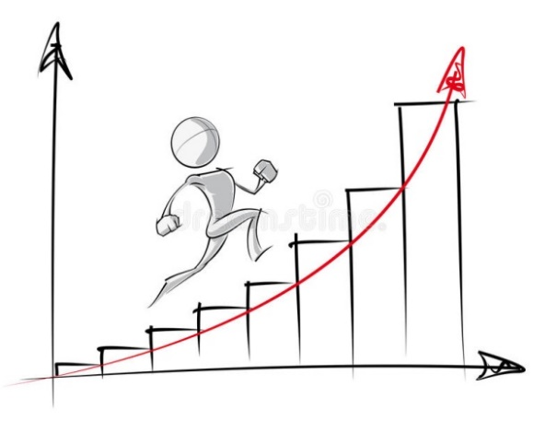
The timing constrains for the World Government
Remember: change pace is nearly exponential
Immature Superintelligence by 2030 must be considered in all political and social initiatives
What impact will AI have on people’s life?
https://sloanreview.mit.edu/article/managing-with-immature-ai/

Slide 19
Technological Unemployment
What will matter most in remaining employed and in career progression?
Notes:
This template can be used as a starter file to give updates for project milestones.
Sections
Right-click on a slide to add sections. Sections can help to organize your slides or facilitate collaboration between multiple authors.
Notes
Use the Notes section for delivery notes or to provide additional details for the audience. View these notes in Presentation View during your presentation.
Keep in mind the font size (important for accessibility, visibility, videotaping, and online production)
Coordinated colors
Pay particular attention to the graphs, charts, and text boxes.
Consider that attendees will print in black and white or grayscale. Run a test print to make sure your colors work when printed in pure black and white and grayscale.
graphics, tables, and graphs
Keep it simple: If possible, use consistent, non-distracting styles and colors.
Label all graphs and tables.

Slide 20
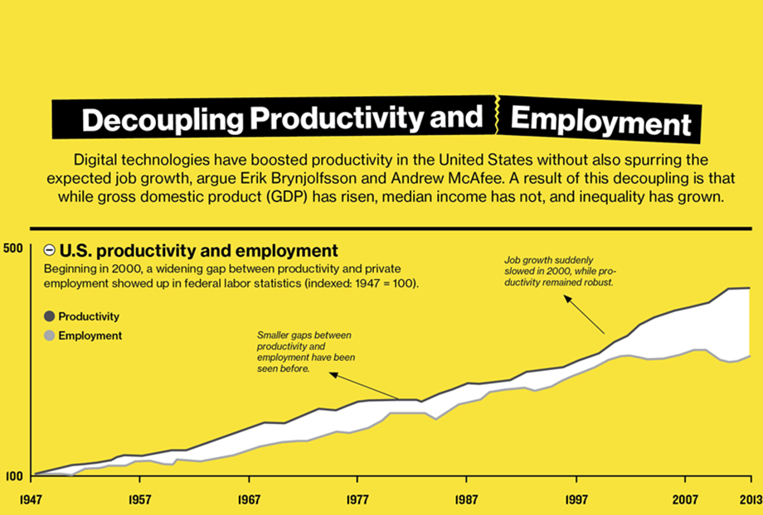
This gap is to rise
almost exponentially
Source: https://www.technologyreview.com/s/515926/how-technology-is-destroying-jobs/

Slide 21
SOME VERY BAD NEWS!
According to the futurist Thomas Frey, by 2030 half of the world’s job types may be gone and over 100 job types may disappears . Assuming there will be 3.5 – 4bn jobs, well over 1bn people may become unemployed
But McKinsey is more optimistic expecting 400-800M people loosing their jobs by 2030 (October 2018 report)
In summary, by 2030:
About 1,000M people (about 30%) world-wide, mostly in Western Hemisphere may become unemployed for a certain period of time during job/skill transition
About 500M may become permanently unemployable
Notes:
This template can be used as a starter file to give updates for project milestones.
Sections
Right-click on a slide to add sections. Sections can help to organize your slides or facilitate collaboration between multiple authors.
Notes
Use the Notes section for delivery notes or to provide additional details for the audience. View these notes in Presentation View during your presentation.
Keep in mind the font size (important for accessibility, visibility, videotaping, and online production)
Coordinated colors
Pay particular attention to the graphs, charts, and text boxes.
Consider that attendees will print in black and white or grayscale. Run a test print to make sure your colors work when printed in pure black and white and grayscale.
graphics, tables, and graphs
Keep it simple: If possible, use consistent, non-distracting styles and colors.
Label all graphs and tables.

Slide 22
Which jobs will most likely disappear by 2030?
Tony Czarnecki based on: Thomas Frey - http://www.futuristspeaker.com/business-trends/101-endangered-jobs-by-2030/
Notes:
‘Low IQ jobs’ will be particularly vulnerable as the table shows. This is also the segments of the society which is most likely to protest violently. But there are also some ‘high IQ’ jobs that will be at risks, such as doctors, lawyers or accountants. We need to prepare right now to minimize such risks.

Slide 23
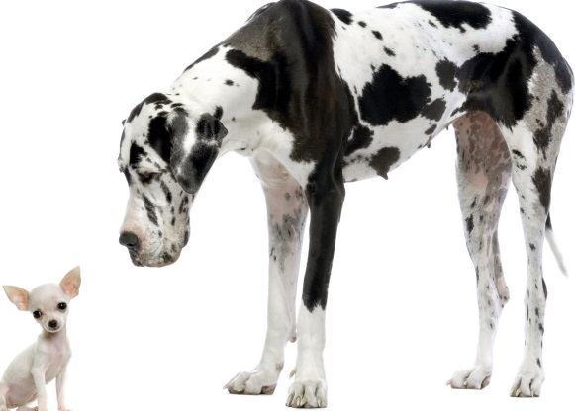
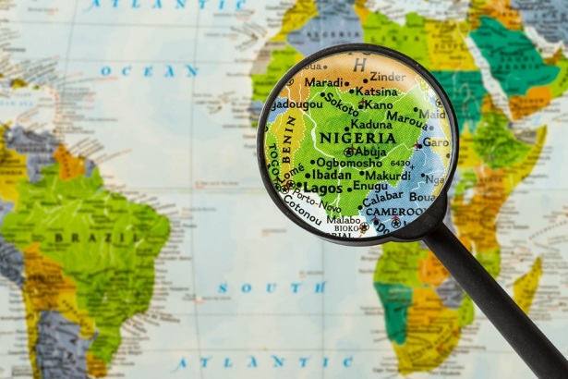
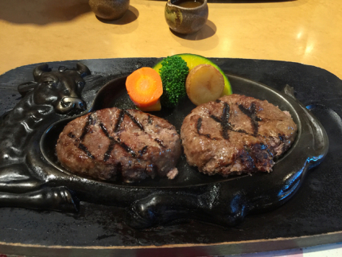
We’ve been there before…
“The great American Society will sort out the problems of technologically originated unemployment because its has always dealt nicely with a crisis” Andrew Paul McAfee is co-director of the MIT Initiative on the Digital Economy
Scale
Spread
Speed
Disruption of
supply-delivery chain
Cross-industry impact:
Amazon - from books to anything
Notes:
Many economists and politicians urge us to calm down – we have been there before, they say. I believe they are utterly wrong.
AI-triggered Technological Unemployment will be of an entirely different Scale – it will impact almost every domain of our life.
It will spread like fire – the iPhone spread to the African jungle in less than 3 years.
The speed of its impact will be driven by exponential pace of change. The cost of an artificial hamburger grown from stem cells has fallen from $315,000 to about $50 now and is expected to fall to $11 within 6 years of the invention.
Total disruption of Supply-Delivery chain – e.g. Amazon Go.
Cross industry impact - from books to selling anything faster and cheaper than anybody else – Amazon again.

Slide 24
So, I do not believe it is an economic or technological problem.
It is primarily a social problem - see American Health System, insurance, lobbying, voting system, gun law. These are all social problems waiting to be resolved…
Notes:
So, should we be worried?
Not everyone thinks so. Andrew McAfee from MIT is not worried at all. However, should we be guided by American irreconcilable optimism?
I do not think so. It’s a social problem not a technological one - see American Health System, insurance, lobbying, voting system, gun law. These are all social problems waiting to be resolved…

Slide 25
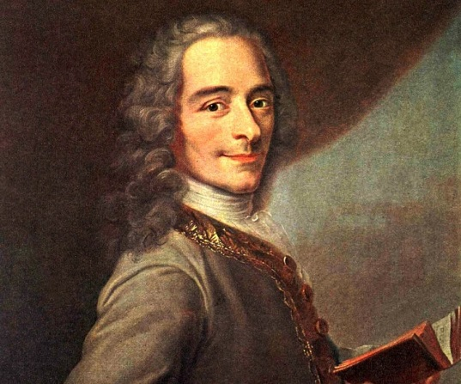
As Voltaire once said:
Work saves a man from three great evils:
Boredom, Vice and Need
Notes:
Someone like Voltaire would probably agree. Work provides for us a safety net, not just as the means supporting our sustenance but as Voltaire puts it:
“WORK Saves a man from three great evils: Boredom, Vice and Need”.

Slide 26
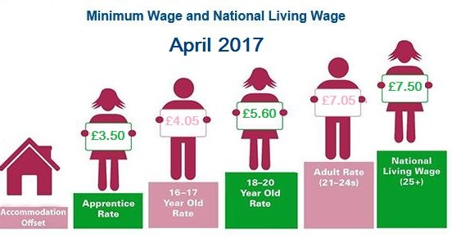
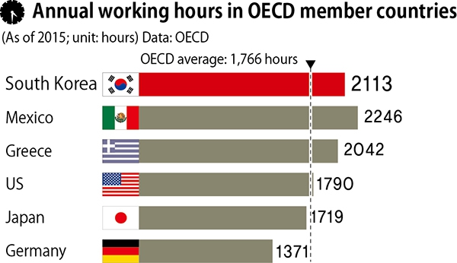
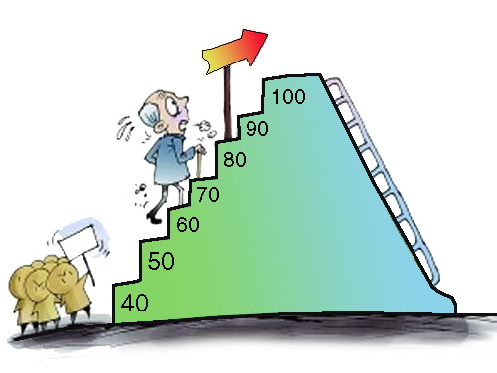
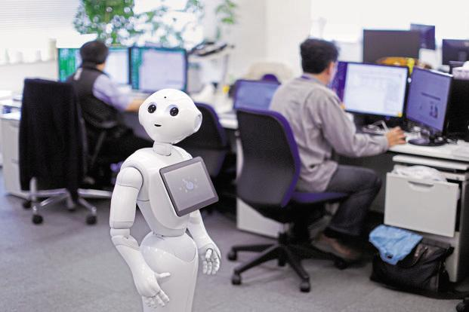
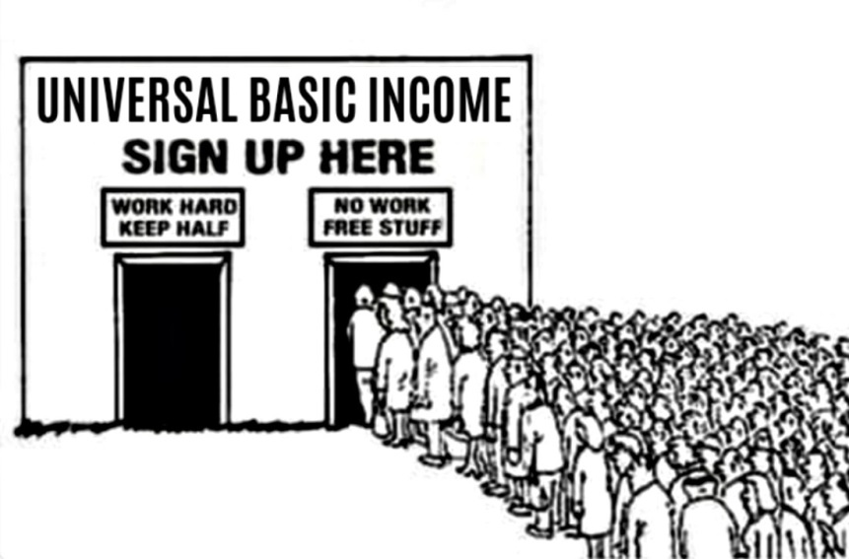
Solutions to minimize the negative impact of AI on the labour market
https://www.cambridgenetwork.co.uk/news/april-2017-national-minimum-wage-and-national-living-wage/
Increase living wage
Cut down working hours
Flexible retirement age
Redesign jobs for sharing, incl. robots
Introduce UBI early and combine it with large scale social engagement programmes
Coaching in ‘life skills’
Personal Life Mentor
Notes:
Cut down working hours – in the UK 1,670 – cut it down progressively over 10 years by 30% to about 1,200 – below the current German level.
Flexible early retirement to receive the government pension earlier, not available in the UK.
Jobs share – about 37% of companies in the EU have job sharing. It needs to rise much faster
Personal Life Mentor
This is an idea I have been working on the side-lines for over 10 years and which I have discussed with one of the London Universities and an AI company. Knowing how fast the market operates it will probably not be me, who gets that product on the market. The important message is that such a product will certainly be developed most likely in less than 5 years’ time. So, I am using the features offered by my prototype as it had been available in the future product. What would be those features?
In a nutshell, such an application available on a smartphone or other medium would communicate with the user in a natural language, which Personal Assistants can do quite well even today. But of course it will be a much more sophisticated Personal Life Mentor that would acquire through a series of long structured conversations with you, an almost absolute knowledge about you. It would know who you are as an individual, your psychological profile, your character traits, your life goals, objectives, and daily tasks, your strengths and weaknesses, your opportunities and threats, your skills, education, friends, family members, your detailed life journey with pictures and video.
Introduce UBI early - this is what the rest of my presentation will be about.

Slide 27
SOME VERY GOOD NEWS!
GDP will rise much faster than most economists or organizations e.g. OECD, predict (2.5 – 3.5%) – result of exponential change. E.g. McKinsey’s October 2018 report estimates 1.2% additional GDP growth annually by 2030
Notes:
This template can be used as a starter file to give updates for project milestones.
Sections
Right-click on a slide to add sections. Sections can help to organize your slides or facilitate collaboration between multiple authors.
Notes
Use the Notes section for delivery notes or to provide additional details for the audience. View these notes in Presentation View during your presentation.
Keep in mind the font size (important for accessibility, visibility, videotaping, and online production)
Coordinated colors
Pay particular attention to the graphs, charts, and text boxes.
Consider that attendees will print in black and white or grayscale. Run a test print to make sure your colors work when printed in pure black and white and grayscale.
graphics, tables, and graphs
Keep it simple: If possible, use consistent, non-distracting styles and colors.
Label all graphs and tables.

Slide 28
What would be the reasons behind such a fast GDP growth?
If we assume Moore’s law to continue over the next 15 years, then the technology would be about 1,000 times more efficient by about 2030
Therefore, the global GDP will grow much faster and will double not in 20 years but in about a decade (more in line with McKinseys forecast)
Notes:
This template can be used as a starter file to give updates for project milestones.
Sections
Right-click on a slide to add sections. Sections can help to organize your slides or facilitate collaboration between multiple authors.
Notes
Use the Notes section for delivery notes or to provide additional details for the audience. View these notes in Presentation View during your presentation.
Keep in mind the font size (important for accessibility, visibility, videotaping, and online production)
Coordinated colors
Pay particular attention to the graphs, charts, and text boxes.
Consider that attendees will print in black and white or grayscale. Run a test print to make sure your colors work when printed in pure black and white and grayscale.
graphics, tables, and graphs
Keep it simple: If possible, use consistent, non-distracting styles and colors.
Label all graphs and tables.

Slide 29
Over 160 new skills in 2030 but what does it mean?
Change in occupations across sectors and regions
Most of new skills will be ‘soft’ and require high education level e.g. bio-meat factory engineers, memory augmentation specialists or super baby designers
Some soft skills will be low-level education e.g. home carers
Partial automation will require co-working with robots
New jobs may pay less e.g. Ford $8 for robots, $25 for workers
Notes:
This template can be used as a starter file to give updates for project milestones.
Sections
Right-click on a slide to add sections. Sections can help to organize your slides or facilitate collaboration between multiple authors.
Notes
Use the Notes section for delivery notes or to provide additional details for the audience. View these notes in Presentation View during your presentation.
Keep in mind the font size (important for accessibility, visibility, videotaping, and online production)
Coordinated colors
Pay particular attention to the graphs, charts, and text boxes.
Consider that attendees will print in black and white or grayscale. Run a test print to make sure your colors work when printed in pure black and white and grayscale.
graphics, tables, and graphs
Keep it simple: If possible, use consistent, non-distracting styles and colors.
Label all graphs and tables.

Slide 30
Which new skills will be needed by 2030?
Tony Czarnecki based on: Thomas Frey - http://www.futuristspeaker.com/business-trends/101-endangered-jobs-by-2030/

Slide 31
What will matter most in career progression and being employed?
Being good at taking initiative (having entrepreneurial skills)
Being innovative and creative
Having leadership abilities
Having systems thinking ability
Having the ability to see the wholeness and the detail
Being good at problem-solving
Being technology savvy
Being adaptive to fundamental shifts in society will require new communication, social and even ethical skills in the age when robots may have ‘human’ rights
Notes:
This template can be used as a starter file to give updates for project milestones.
Sections
Right-click on a slide to add sections. Sections can help to organize your slides or facilitate collaboration between multiple authors.
Notes
Use the Notes section for delivery notes or to provide additional details for the audience. View these notes in Presentation View during your presentation.
Keep in mind the font size (important for accessibility, visibility, videotaping, and online production)
Coordinated colors
Pay particular attention to the graphs, charts, and text boxes.
Consider that attendees will print in black and white or grayscale. Run a test print to make sure your colors work when printed in pure black and white and grayscale.
graphics, tables, and graphs
Keep it simple: If possible, use consistent, non-distracting styles and colors.
Label all graphs and tables.

Slide 32
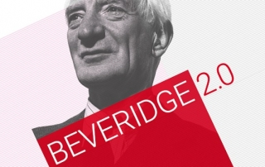
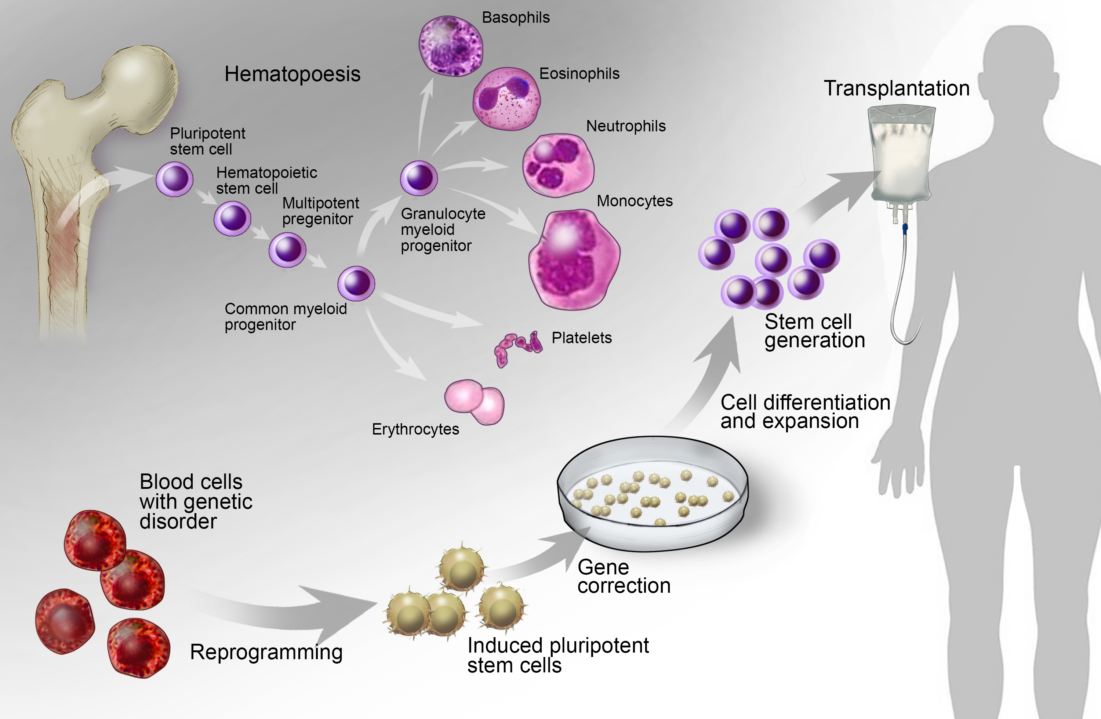
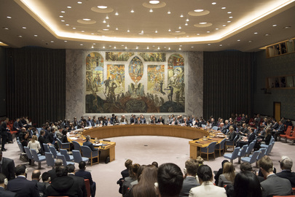
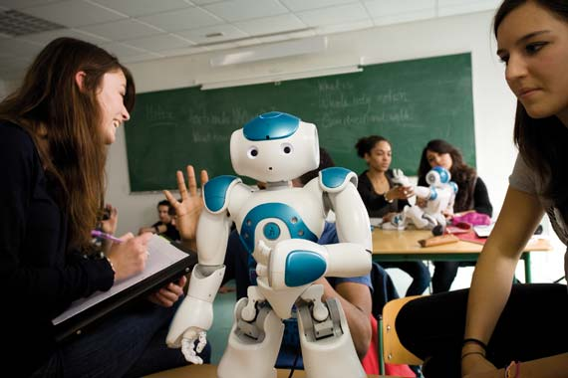
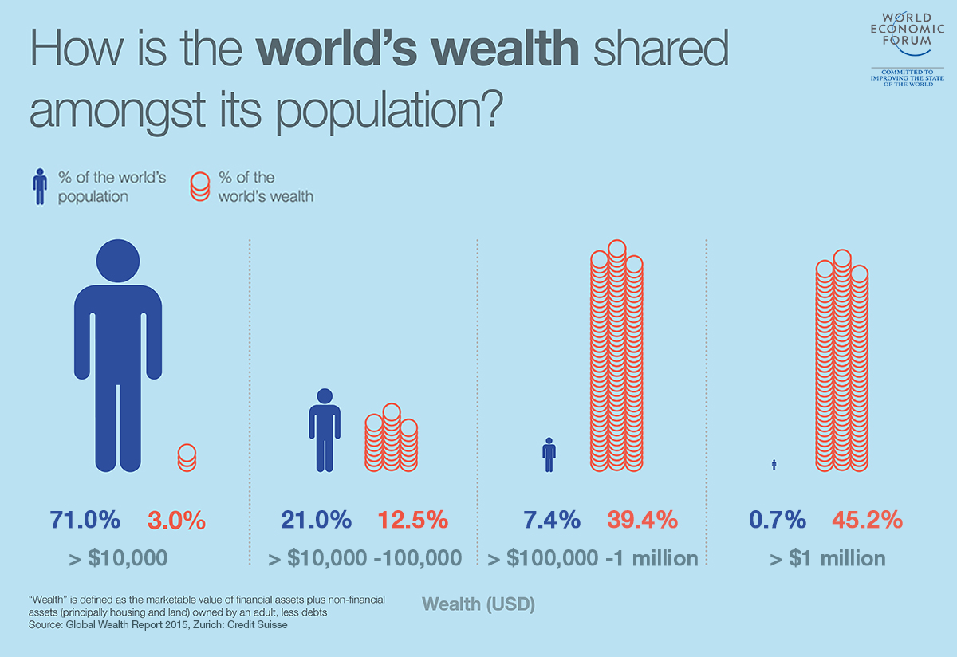
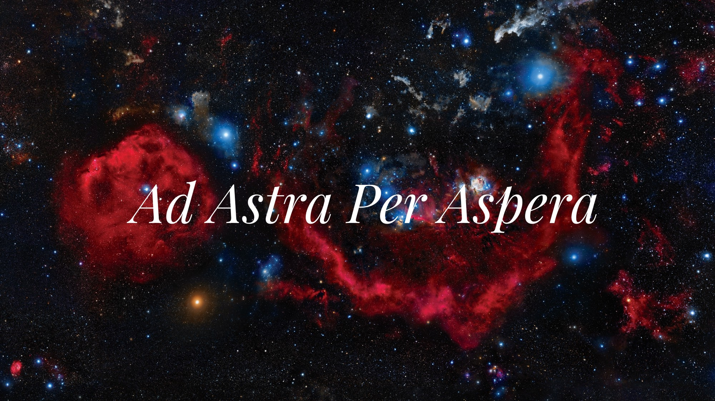
The benefits of Superintelligence – living in the world of abundance
Super Welfare State
Regenerative medicine
New democracy, politics and the end of global wars!
1% of the world’s population owns half of the world’s wealth
Education
Global Wealth Redistribution Fund
Enabling expansion
to other planets
Notes:
Cut down working hours – in the UK 1,670 – cut it down progressively over 10 years by 30% to about 1,200 – below the current German level.
Flexible early retirement to receive the government pension earlier, not available in the UK.
Jobs share – about 37% of companies in the EU have job sharing. It needs to rise much faster
Personal Life Mentor
This is an idea I have been working on the side-lines for over 10 years and which I have discussed with one of the London Universities and an AI company. Knowing how fast the market operates it will probably not be me, who gets that product on the market. The important message is that such a product will certainly be developed most likely in less than 5 years’ time. So, I am using the features offered by my prototype as it had been available in the future product. What would be those features?
In a nutshell, such an application available on a smartphone or other medium would communicate with the user in a natural language, which Personal Assistants can do quite well even today. But of course it will be a much more sophisticated Personal Life Mentor that would acquire through a series of long structured conversations with you, an almost absolute knowledge about you. It would know who you are as an individual, your psychological profile, your character traits, your life goals, objectives, and daily tasks, your strengths and weaknesses, your opportunities and threats, your skills, education, friends, family members, your detailed life journey with pictures and video.
Introduce UBI early - this is what the rest of my presentation will be about.

Slide 33
Can we be optimistic about AI becoming benevolent?
I do not believe a transition to Superintelligence will be implemented in a rational, well-coordinated way
Most probably the world will go first through a near existential risk (e.g. sparked off by immature Superintelligence) before it changes fundamentally the way humanity is governed
We are learning: take two most recent difficult global problems:
Ebola – speed of vaccine delivery
The Paris Accord on climate change – the duration, impact and extent of acceptance
Small steps like this could be the first paving stones on the road to a safer and just world that will provide enough wealth to be shared by everyone
Notes:
This template can be used as a starter file to give updates for project milestones.
Sections
Right-click on a slide to add sections. Sections can help to organize your slides or facilitate collaboration between multiple authors.
Notes
Use the Notes section for delivery notes or to provide additional details for the audience. View these notes in Presentation View during your presentation.
Keep in mind the font size (important for accessibility, visibility, videotaping, and online production)
Coordinated colors
Pay particular attention to the graphs, charts, and text boxes.
Consider that attendees will print in black and white or grayscale. Run a test print to make sure your colors work when printed in pure black and white and grayscale.
graphics, tables, and graphs
Keep it simple: If possible, use consistent, non-distracting styles and colors.
Label all graphs and tables.

Slide 34
END
www.sustensis.co.uk

